Slide 1


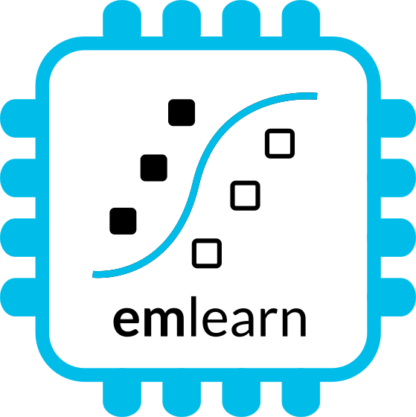
Machine Learning for Microcontrollers
with Zephyr and emlearn
https://github.com/emlearn/emlearn
Jon Nordby jononor@gmail.com
August 2025, Amsterdam

Slide 2
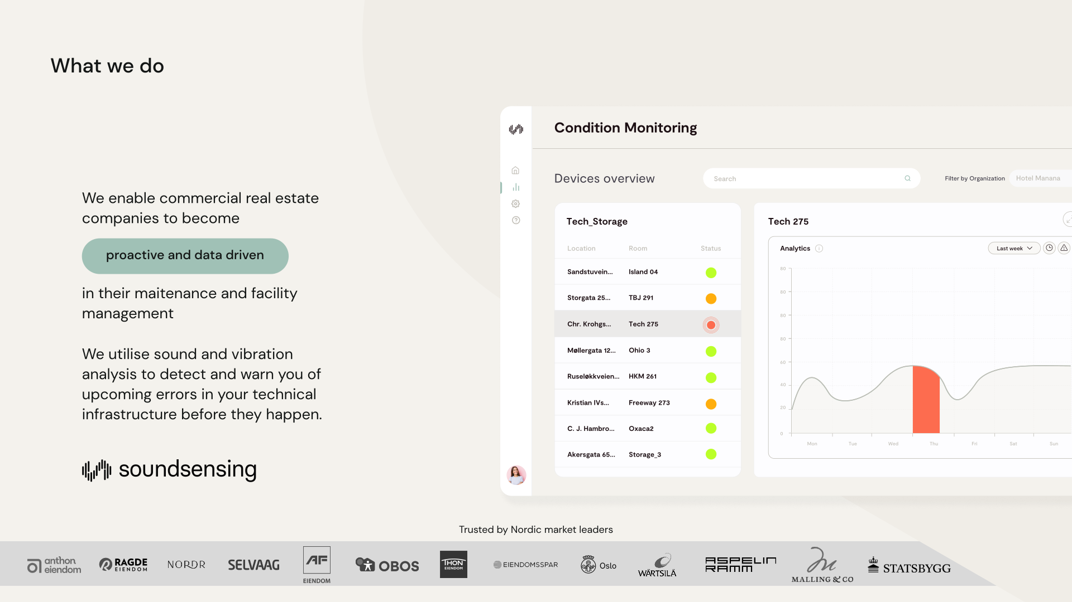


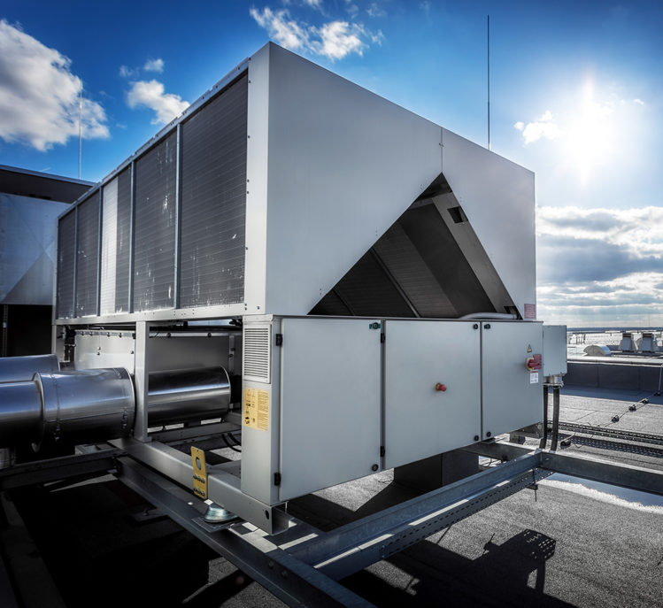
Notes:
Work as Head of Data Science at Soundsensing.
Soundsensing is a leading provider of predictive maintenance solutions for ventilation systems in buildings. So we work a lot with sensor data. And also use Python as much as we can for Data Science, IoT and backend tasks.

Slide 3
Goal & structure of this talk
You, as an embedded software engineer
become familiar with how to
develop & deploy Machine Learning
on a microcontroller
using Zephyr and emlearn
Outline
Case: Activity Recognition
Reading sensors
Creating dataset
Training model
Deploying model
Bonus: MicroPython
Notes:
As a brief structure of this presentation

Slide 4
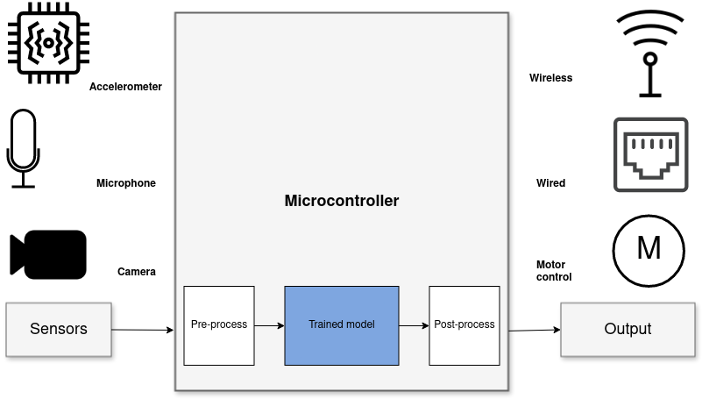
Sensor data analysis with Machine Learning
Benefits vs sending data to cloud
Stand-alone
Low latency
Power efficiency
Privacy
Low cost
1) Read sensors –> 2) Process data * –> 3) Transmit/act * including Digital Signal Processing (DSP) and Machine Learning (ML)
Notes:
When it comes to Machine Learning on microcontrollers,
we are obviously not going to be running any Large Language Models or generative image models.
But one usecase where ML is incredibly useful is in analysing sensor data.
Sensors such as accelerometers, microphonones, radars, and cameras have gotten incredibly cheap and powerful.
But in order to get useful information out of these, the raw data must be processed.
Using Machine Learning, in combination with Digital Signal Processing, allows analyzing complex phenomena.
If this is done on the microcontroller, we get a range of benefits:
...
The component in blue is the Machine Learning model, and is typically trained ahead of time on a PC.

Slide 5
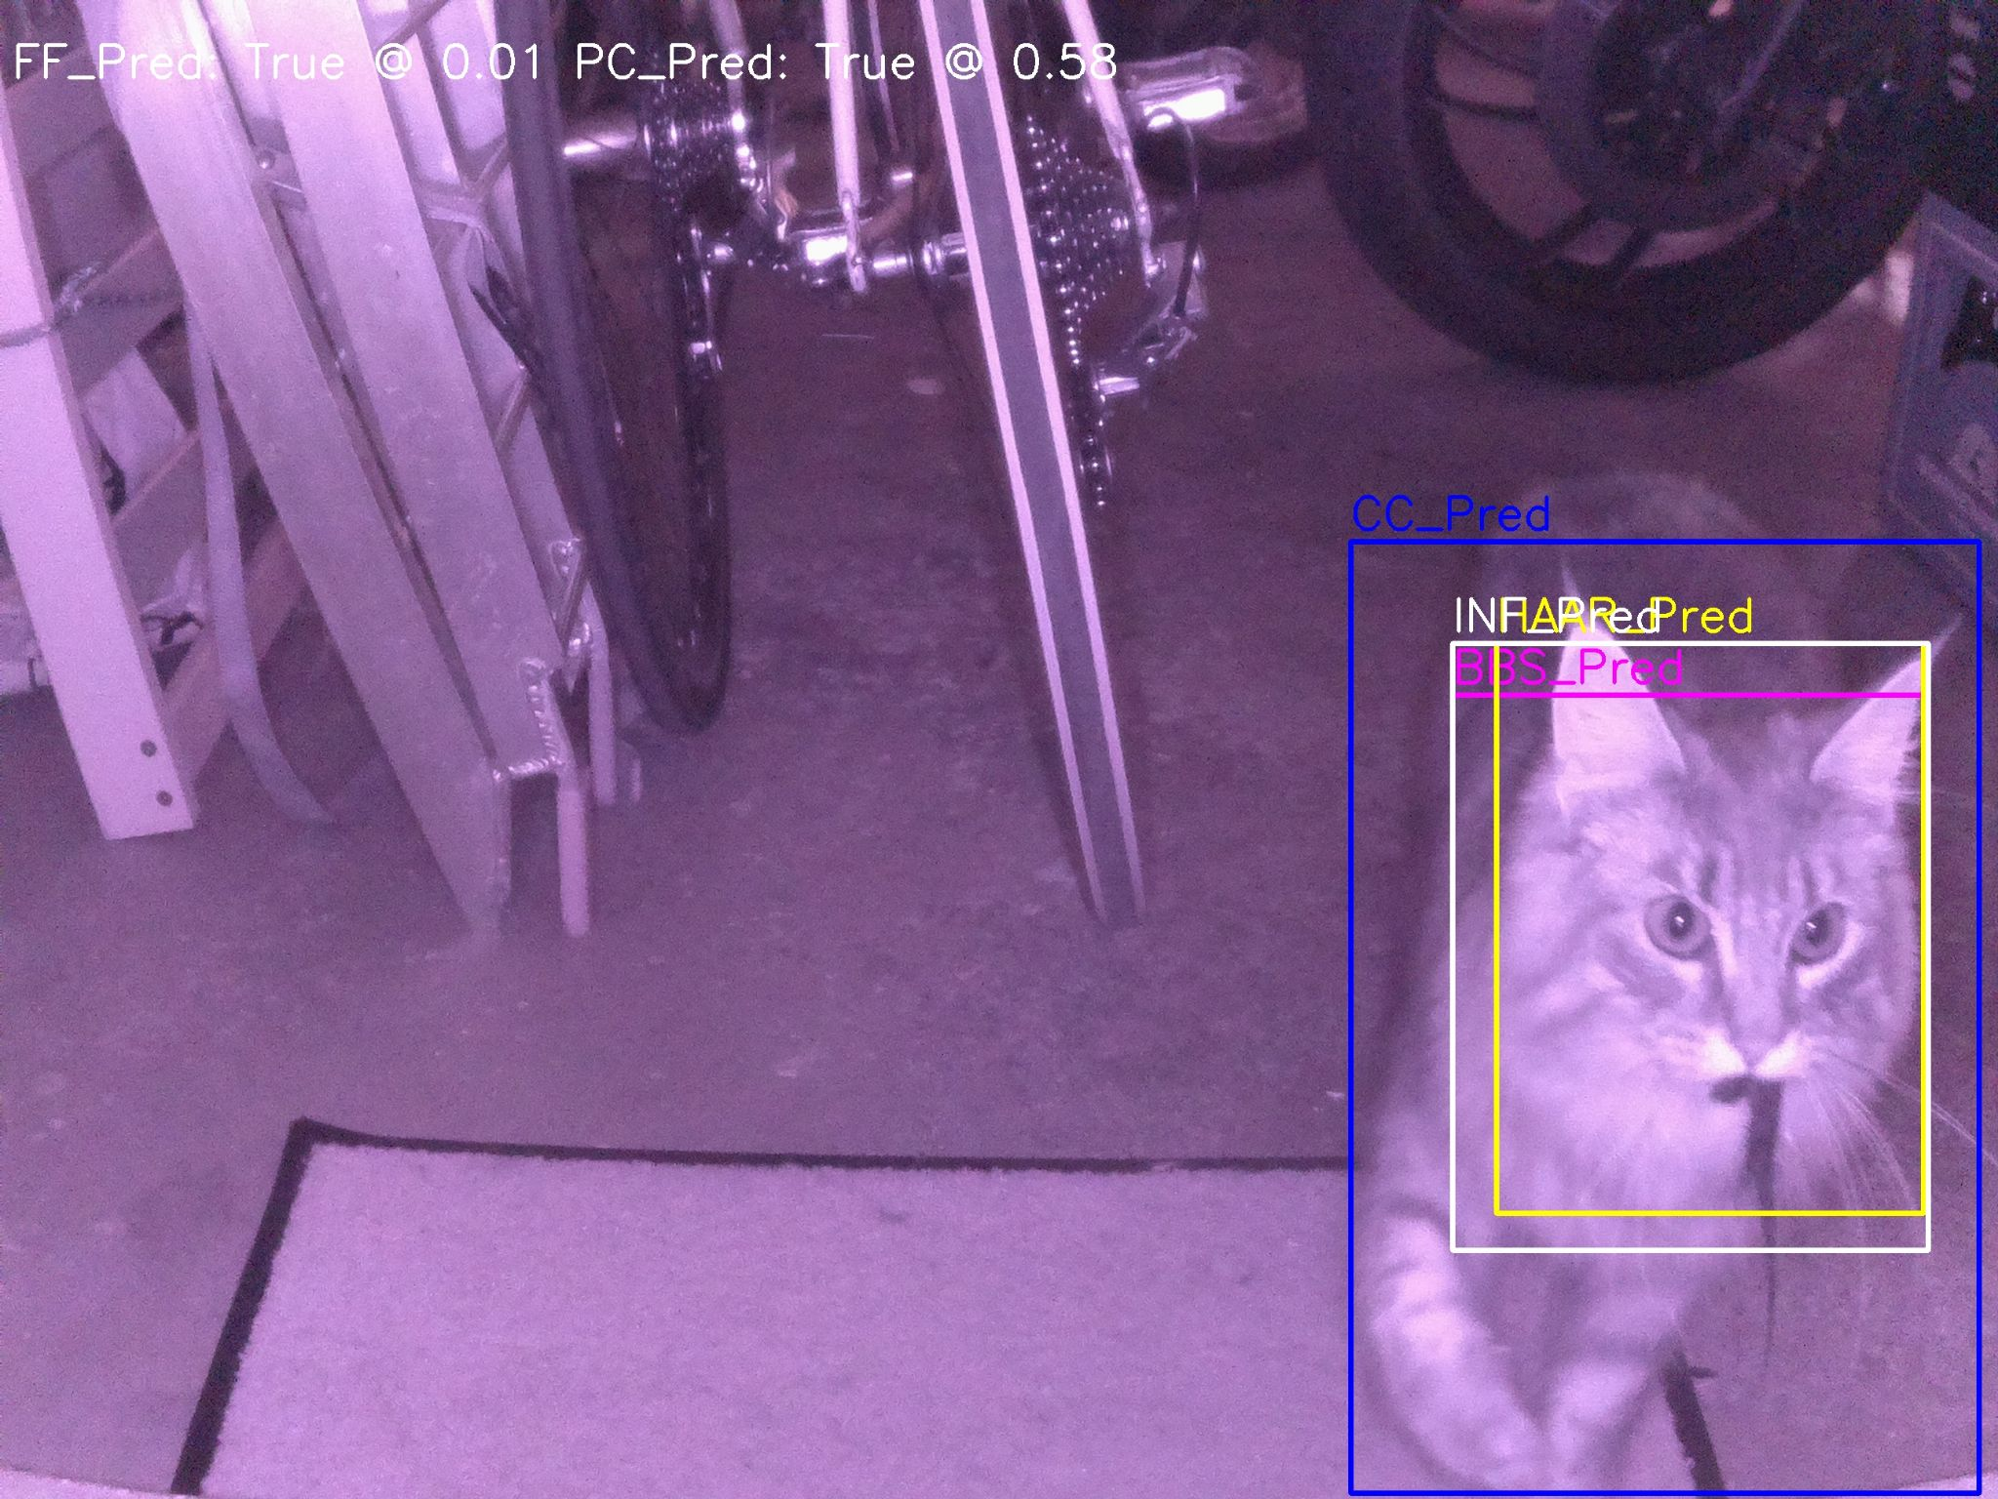
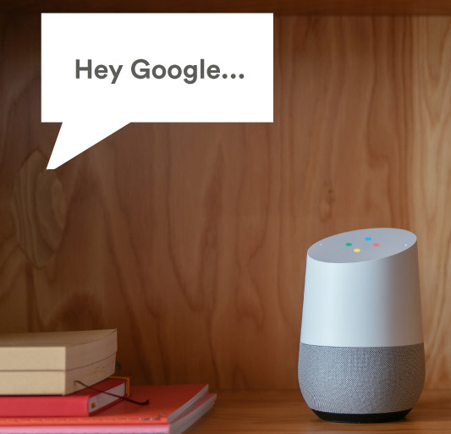
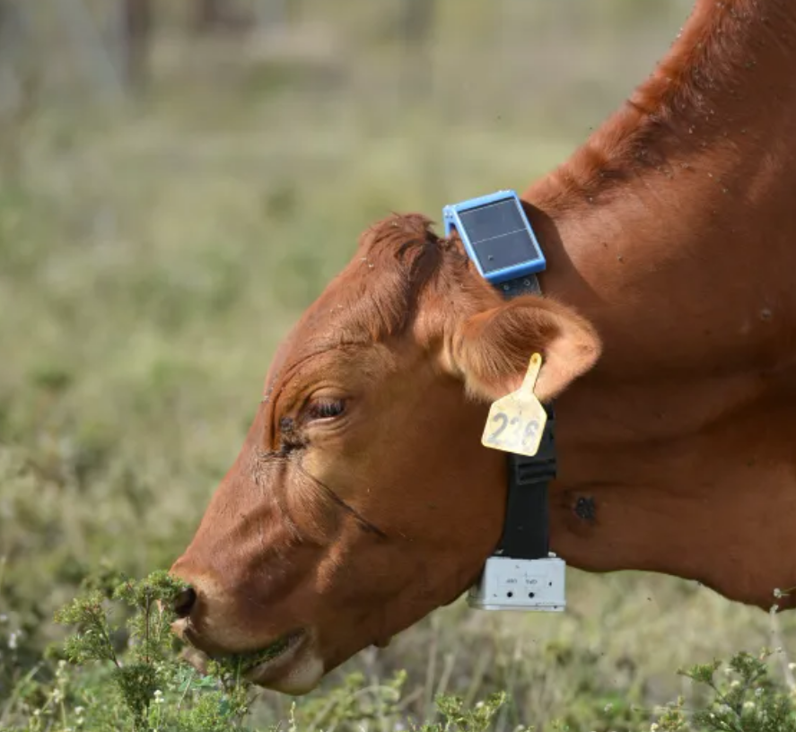
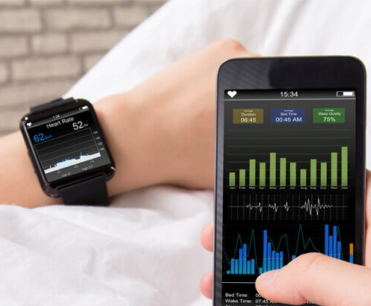
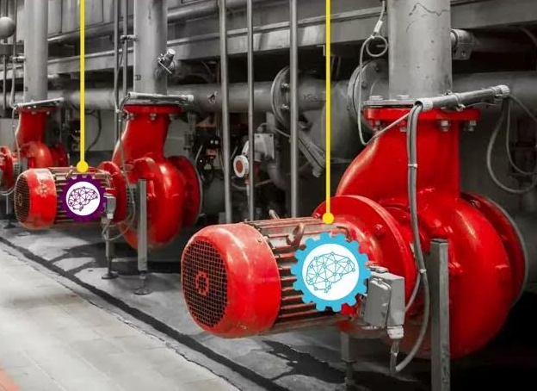
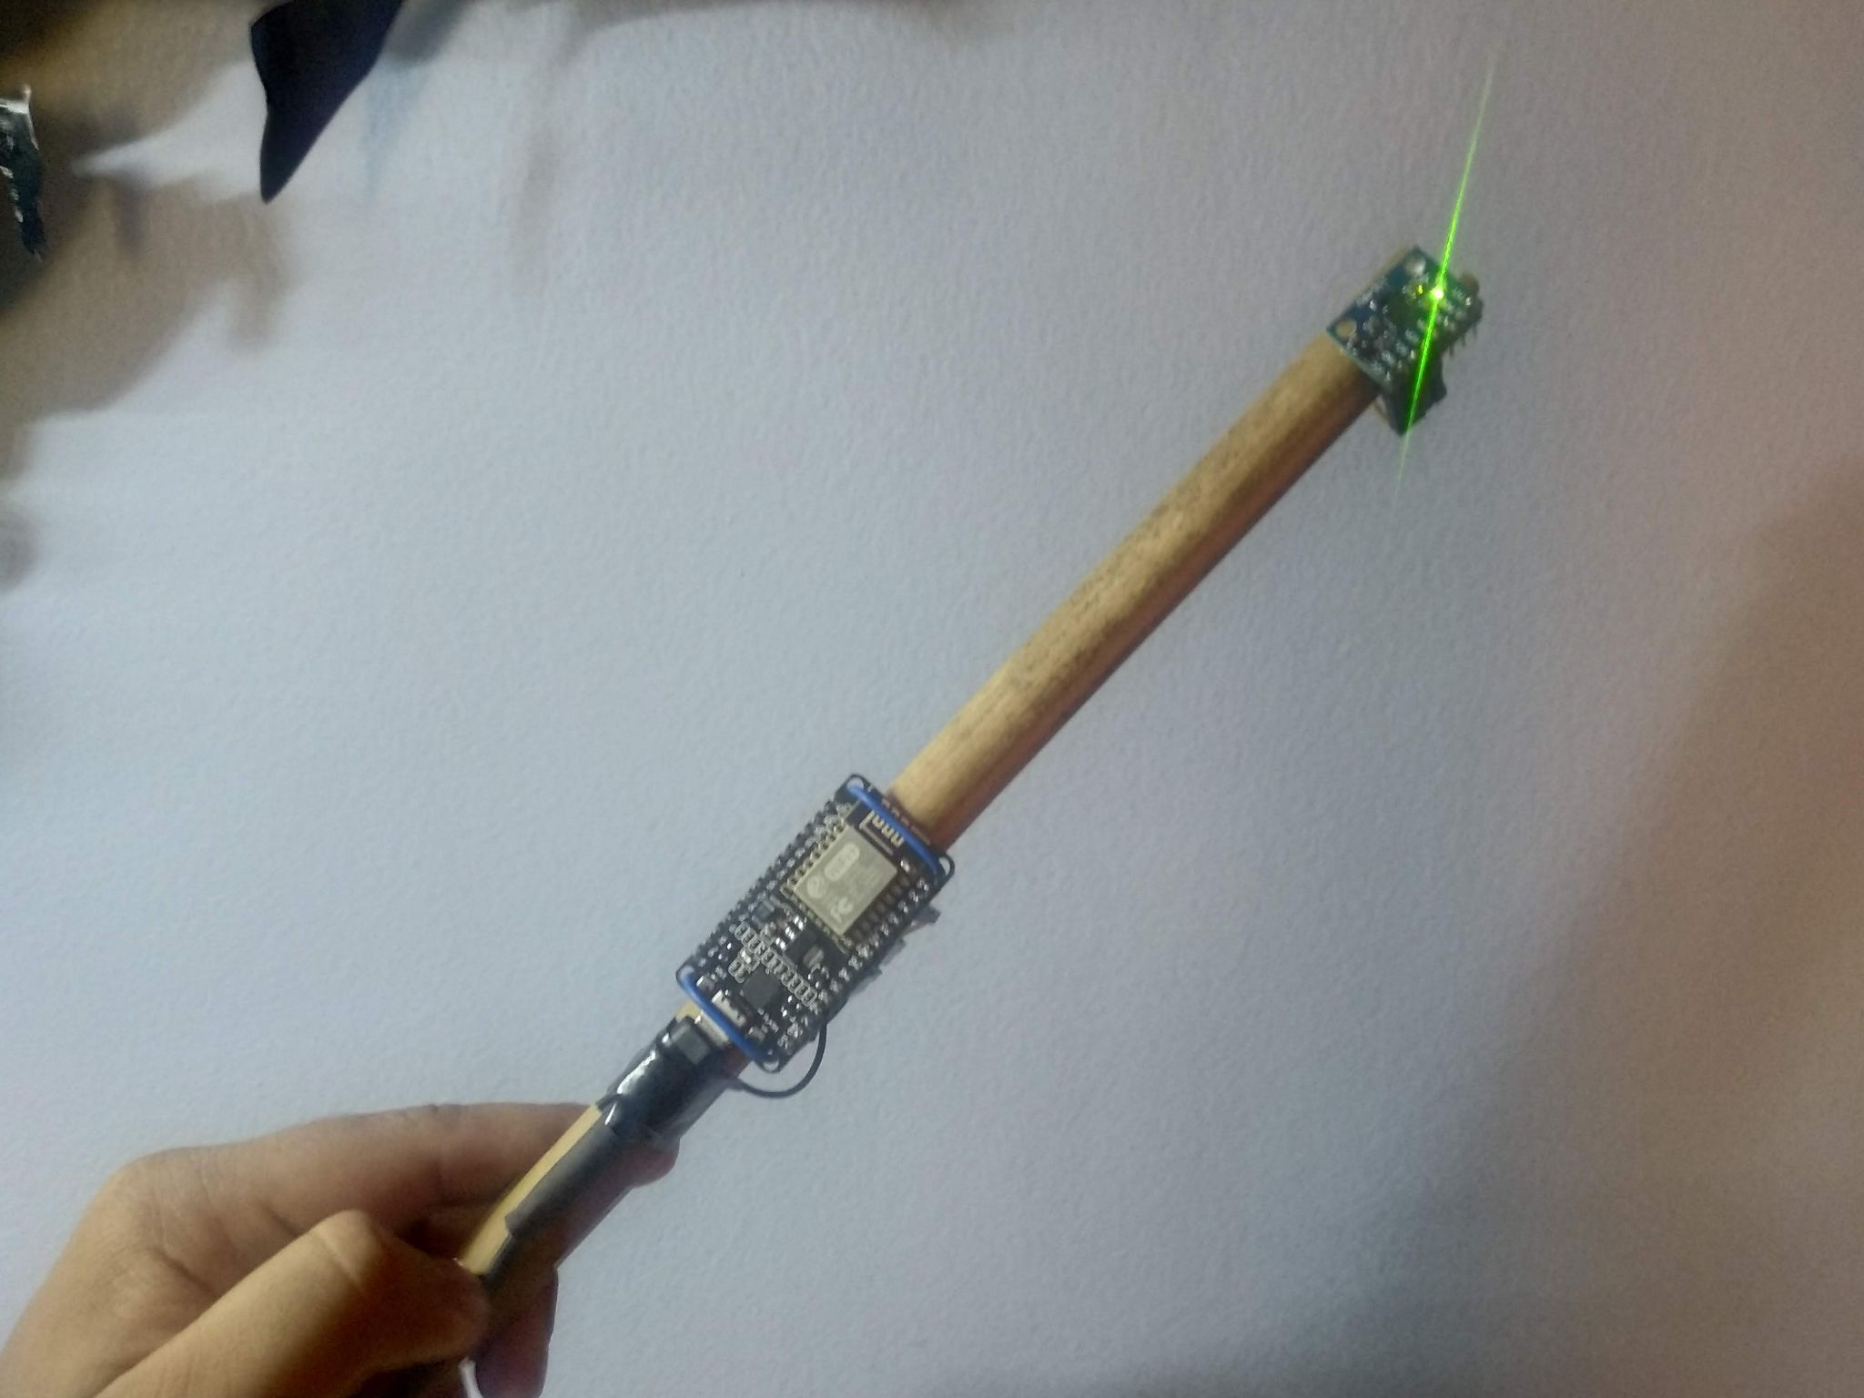
Applications
Consumer Tech
Industrial
Fun
Notes:
This is a huge amount of applications for this, in basically any field that uses electronics.
Keyword spotting / wakeword detection. “Alexa” Smartwatch. Sleep activity tracking Agriculture. Cattle activity tracking Condition monitoring of Machinery.
Or what about a cat doorbell that only lets in your cat, and only if it does not have a prey in its both. Magic wand.

Slide 6

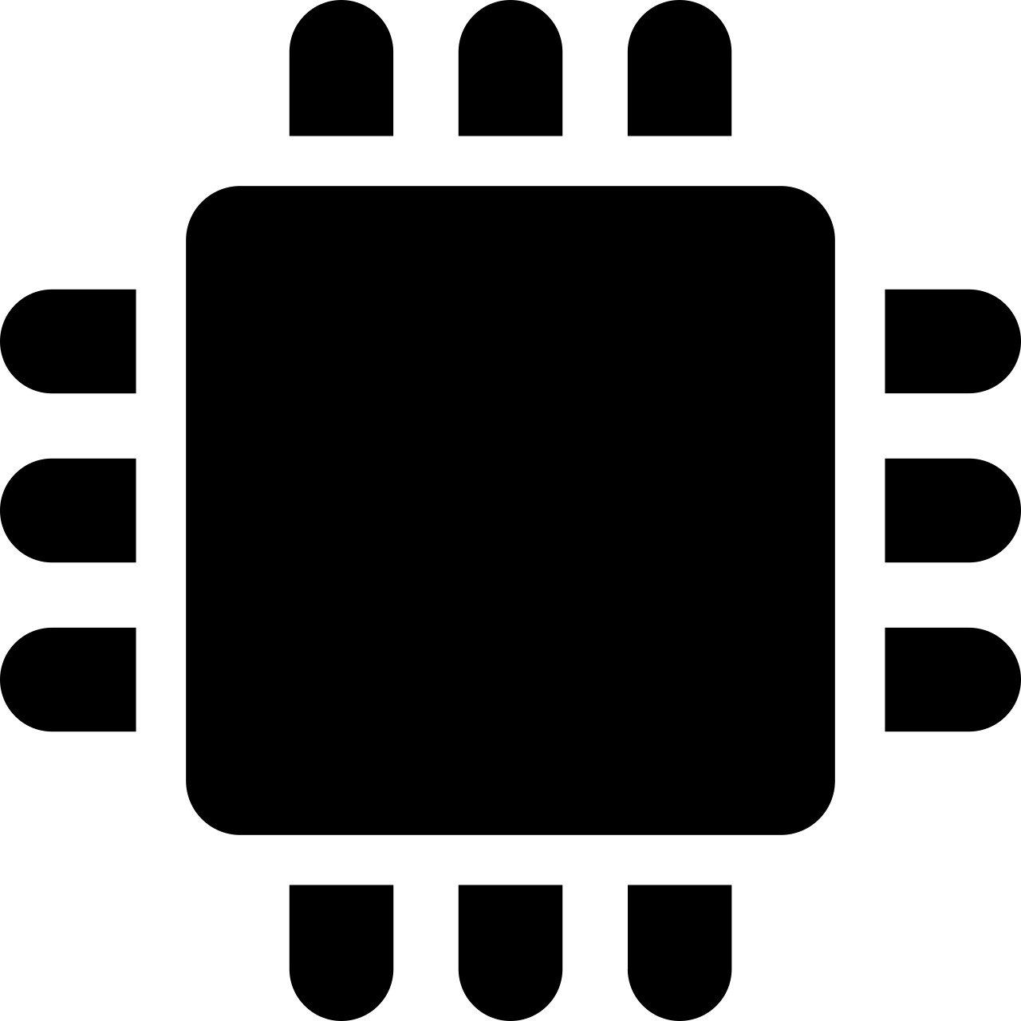





TinyML challenge: PC/host vs embedded/device pipeline
1) Train model on PC
2) Run on Device
Data
Sensor
RAM (min)
10 GB+
?
RAM (max): 1 MB
Pre-process
Pre-process
Model conversion tools
ML model
ML model
?
Embedded optimized pipeline
Deep-learning pipeline
Post-process
Post-process
Challenges
Very different constraints in the two environments
The two pipelines must be 100% compatible
Pre- and post-processing often application-specific, Turing complete
Different languages, tools, libraries, cultures
“Data Scientist land”
“Firmware Engineer land”

Slide 7
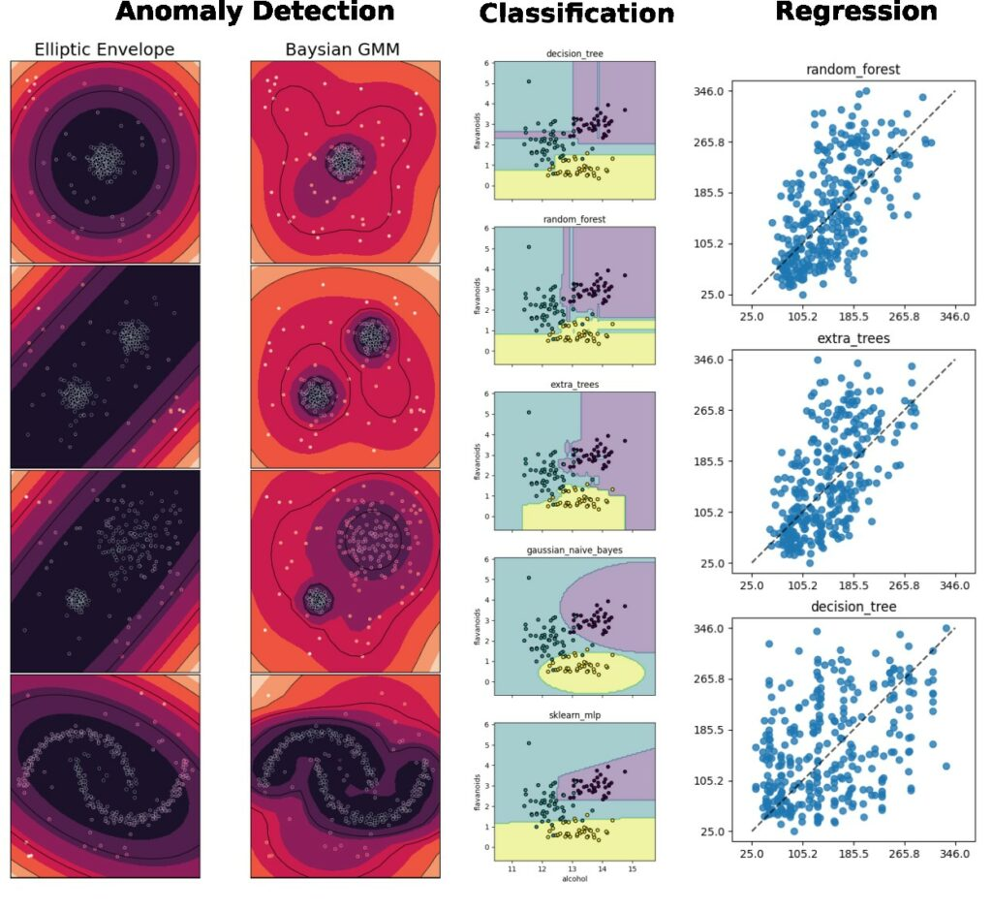
Most common tasks for embedded & sensor data use cases.
Supported by emlearn
Notes:
emlearn supports the three most common ML tasks:
classification, regression, anomaly detection.

Slide 8
Activity Recognition
Using IMU accelerometer/gyro

Slide 9
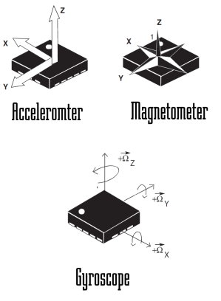
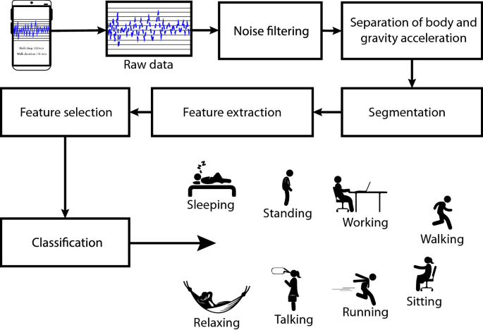
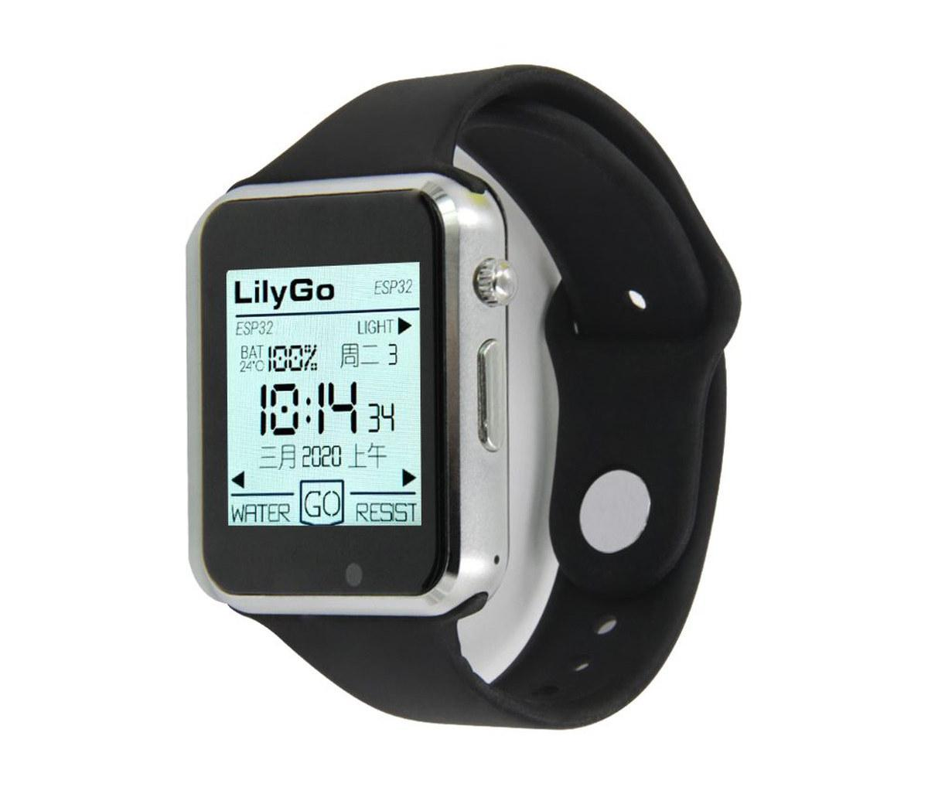
Activity tracker - concept

Slide 10
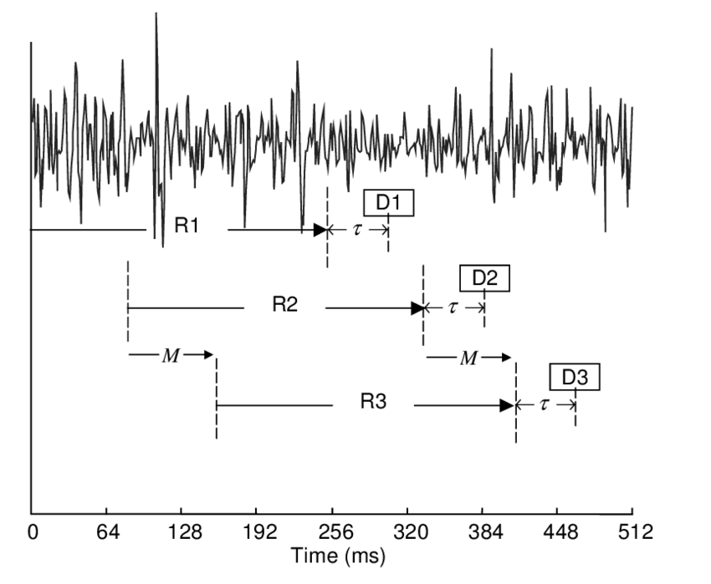
ML on streams: Continuous classification
The sensor data stream is sliced into overlapping windows.
Each window processed independently
Preprocess
Model
Raw sensor data
Features
Class
[ 42, 4002, … , 329 ]
“Jumping Jacks”
Notes:
The sensor data steam is conceptually infinite
The Machine Learning models on the other hand must have finite and fixed-length inputs
This is done by splitting the stream at fixed intervals of time. Into windows
Usually with some overlap. So model gets multiple chances at predicting the same phenomena

Slide 11
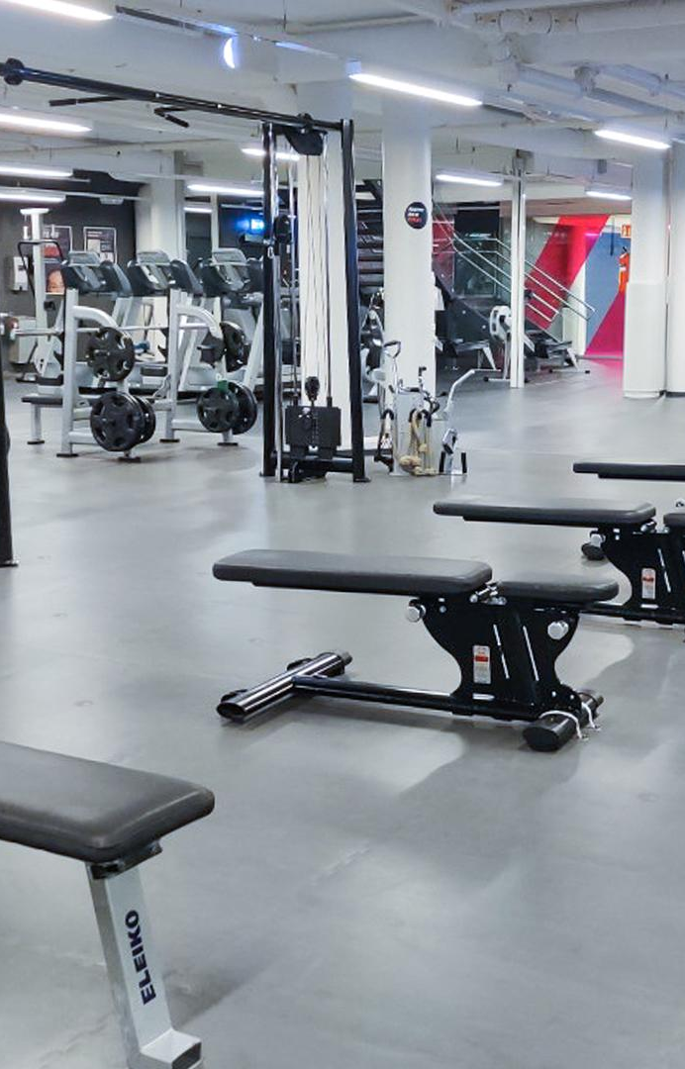
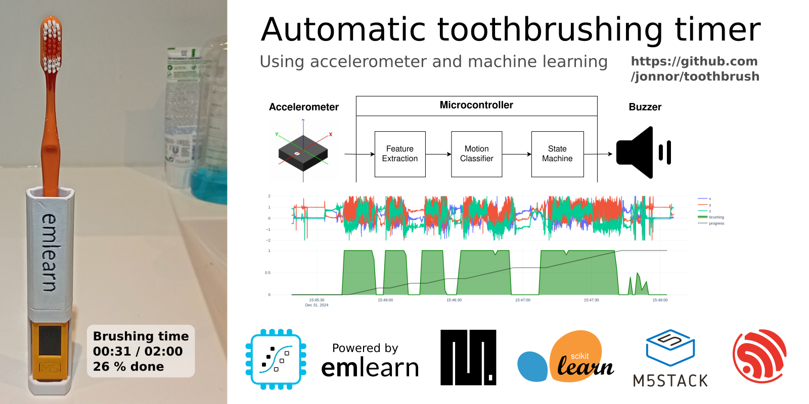
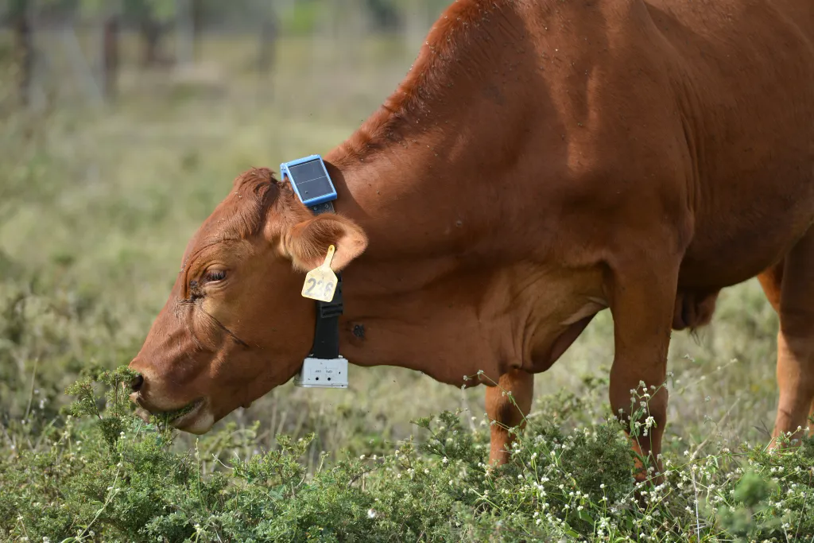
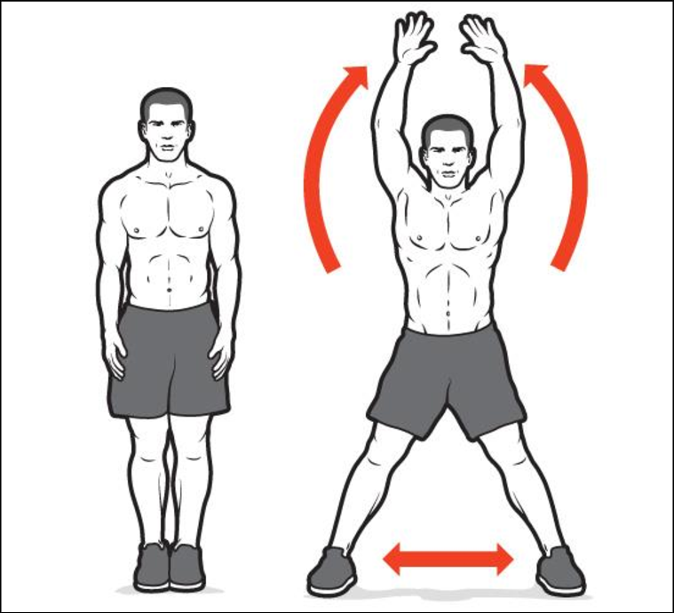
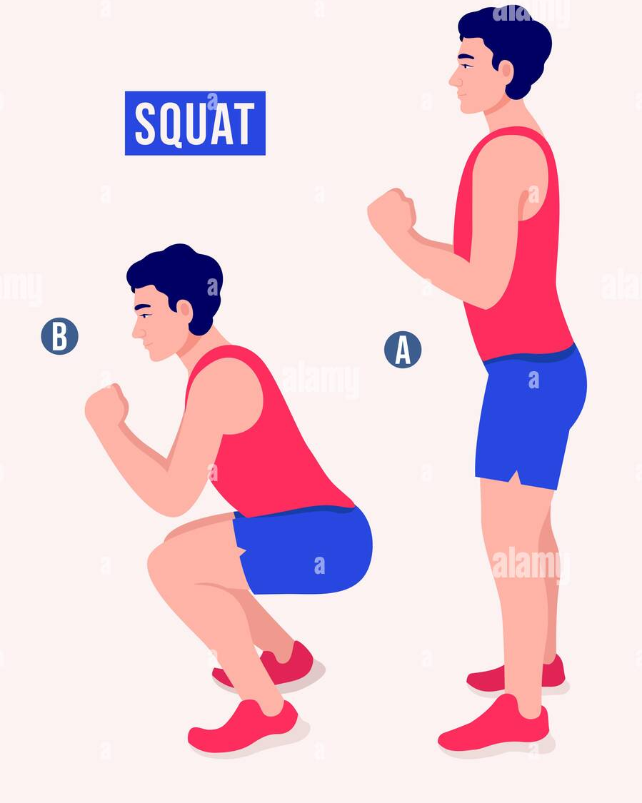
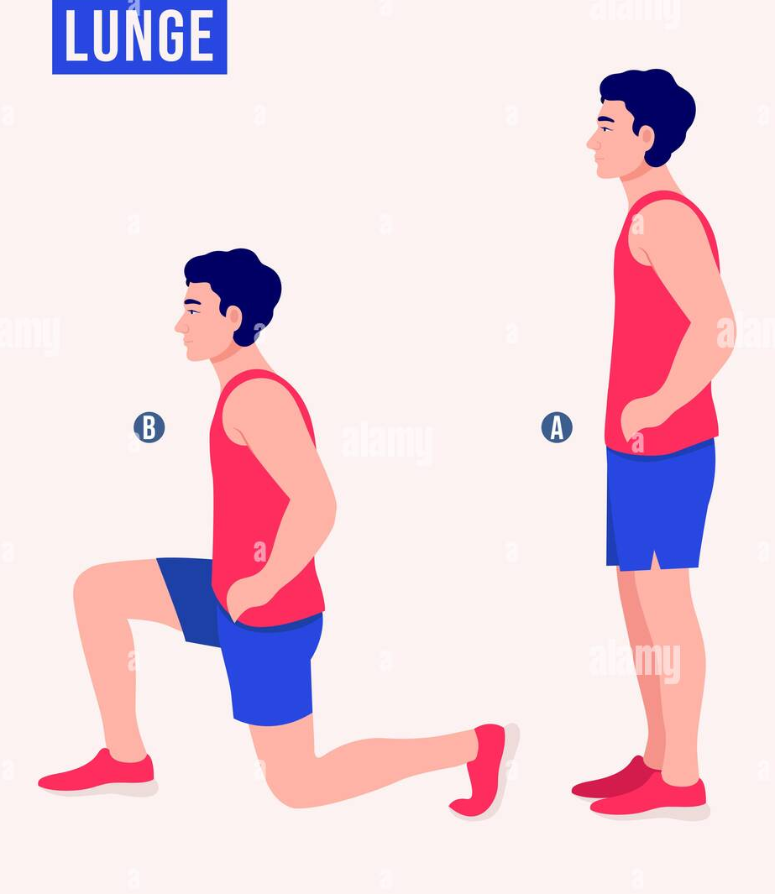
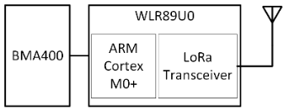

Exercise tracker
Toothbrush timer
Health monitoring for cattle
Power Efficient Wireless Sensor Node through Edge Intelligence
Abhishek Damle (2022)
https://github.com/jonnor/toothbrush/

Slide 12
Reading sensors

Slide 13
ML on streams: Continuous classification
Example config - 4 second window, every 1 second
- 100 Hz samplerate / 10 ms sample interval - Window processing budget: 60 ms
Preprocess
Model
Raw sensor data
Features
Class
[ x1 y1 z1 x2 y2 z2
…. ]
[ 42, 4002, … , 329 ]
“Jumping Jacks”
Notes:
The sensor data steam is conceptually infinite
The Machine Learning models on the other hand must have finite and fixed-length inputs
This is done by splitting the stream at fixed intervals of time. Into windows
Usually with some overlap. So model gets multiple chances at predicting the same phenomena

Slide 14
Polling via sensor fetch&get
Thread 1: Sensor loop | 100 Hz / 10 ms
Thread 2: Application main | 2 Hz / 500 ms
sensor_sample_fetch(self->dev);
// Get data from each channel
for (size_t i = 0; i < self->n_channels; i++) {
sensor_channel_get(self->dev, self->channels[i], &value);
values[i] = sensor_value_to_double(&value);
}
….
if (self->read_samples_index == self->window_length) {
self->read_samples_index = 0;
// copy to dedicated output buffer for application
memcpy(self->output_buffer, self->samples, out_length);
// Send as message
… msg = { 1, self->output_buffer, out_length };
k_msgq_put(self->queue, &msg, K_NO_WAIT);
}
k_usleep(1000000/self->samplerate);
// Setup sensor
configure_sensor(lsm6dsl_dev);
// Start high-priority thread for collecting data
sensor_chunk_reader_start(&reader);
while (1) {
const int get_error = k_msgq_get(reader.queue, &msg, K_NO_WAIT);
if (get_error == 0) {
// pre-process
accelgyro_preprocessor_run(&preprocessor, msg.buffer, msg.length);
// run machine learning model
activity_class = \ activity_model_predict(preprocessor.features, features_length);
// TODO: do something with result
}
k_msleep(100);
}
Pros: Universal, simple Cons: Limits CPU sleep, sample jitter on schedule variation
Practical example https://github.com/emlearn/emlearn/issues/108

Slide 15
Using FIFO in IMU
// Setup sensor, including FIFO enable
configure_sensor(dev);
while (1) {
const int fifo_count = imu_get_fifo_length(dev);
if (fifo_count >= window_length) {
// read in data from IMU
imu_read_into(dev, buffer, window_length);
// pre-process
accelgyro_preprocessor_run(&preprocessor, buffer, length);
// run machine learning model
activity_class = \
activity_model_predict(preprocessor.features, features_length);
// TODO: do something with result
}
k_msleep(100);
}
Built-in FIFO for 32 - 128 samples
At 100 hz, gives 320 - 1280 ms to service
Can (often) use application thread directly
Pros: Perfectly sampled, CPU can sleep, fewer threads
Cons: No DMA support
Implementing an IMU/accelerometer/gyro driver? Use the FIFO!
https://github.com/orgs/micropython/discussions/15512

Slide 16
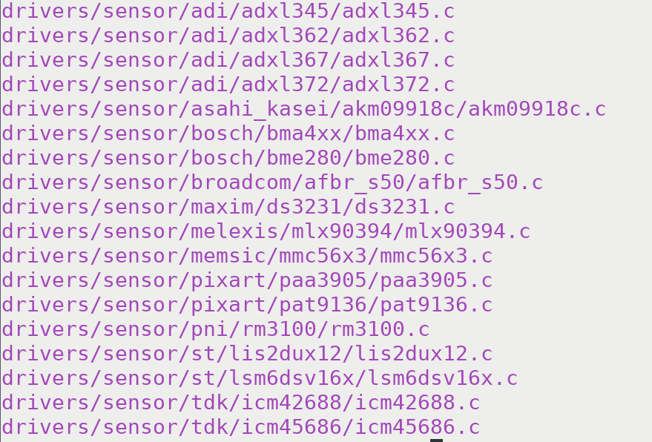
Batching via RTIO and sensor read&decode
Async interface
Can utilize FIFO
Can utilize DMA (I2C/SPI)
Introduced in Zephyr 4.x
As of Zephyr 4.2 - Only 18 drivers support read&decode
Sample: Batch processing with RTIO and read&decode
https://github.com/zephyrproject-rtos/zephyr/blob/main/ samples/subsys/rtio/sensor_batch_processing/src/main.c

Slide 17
Creating dataset

Slide 18
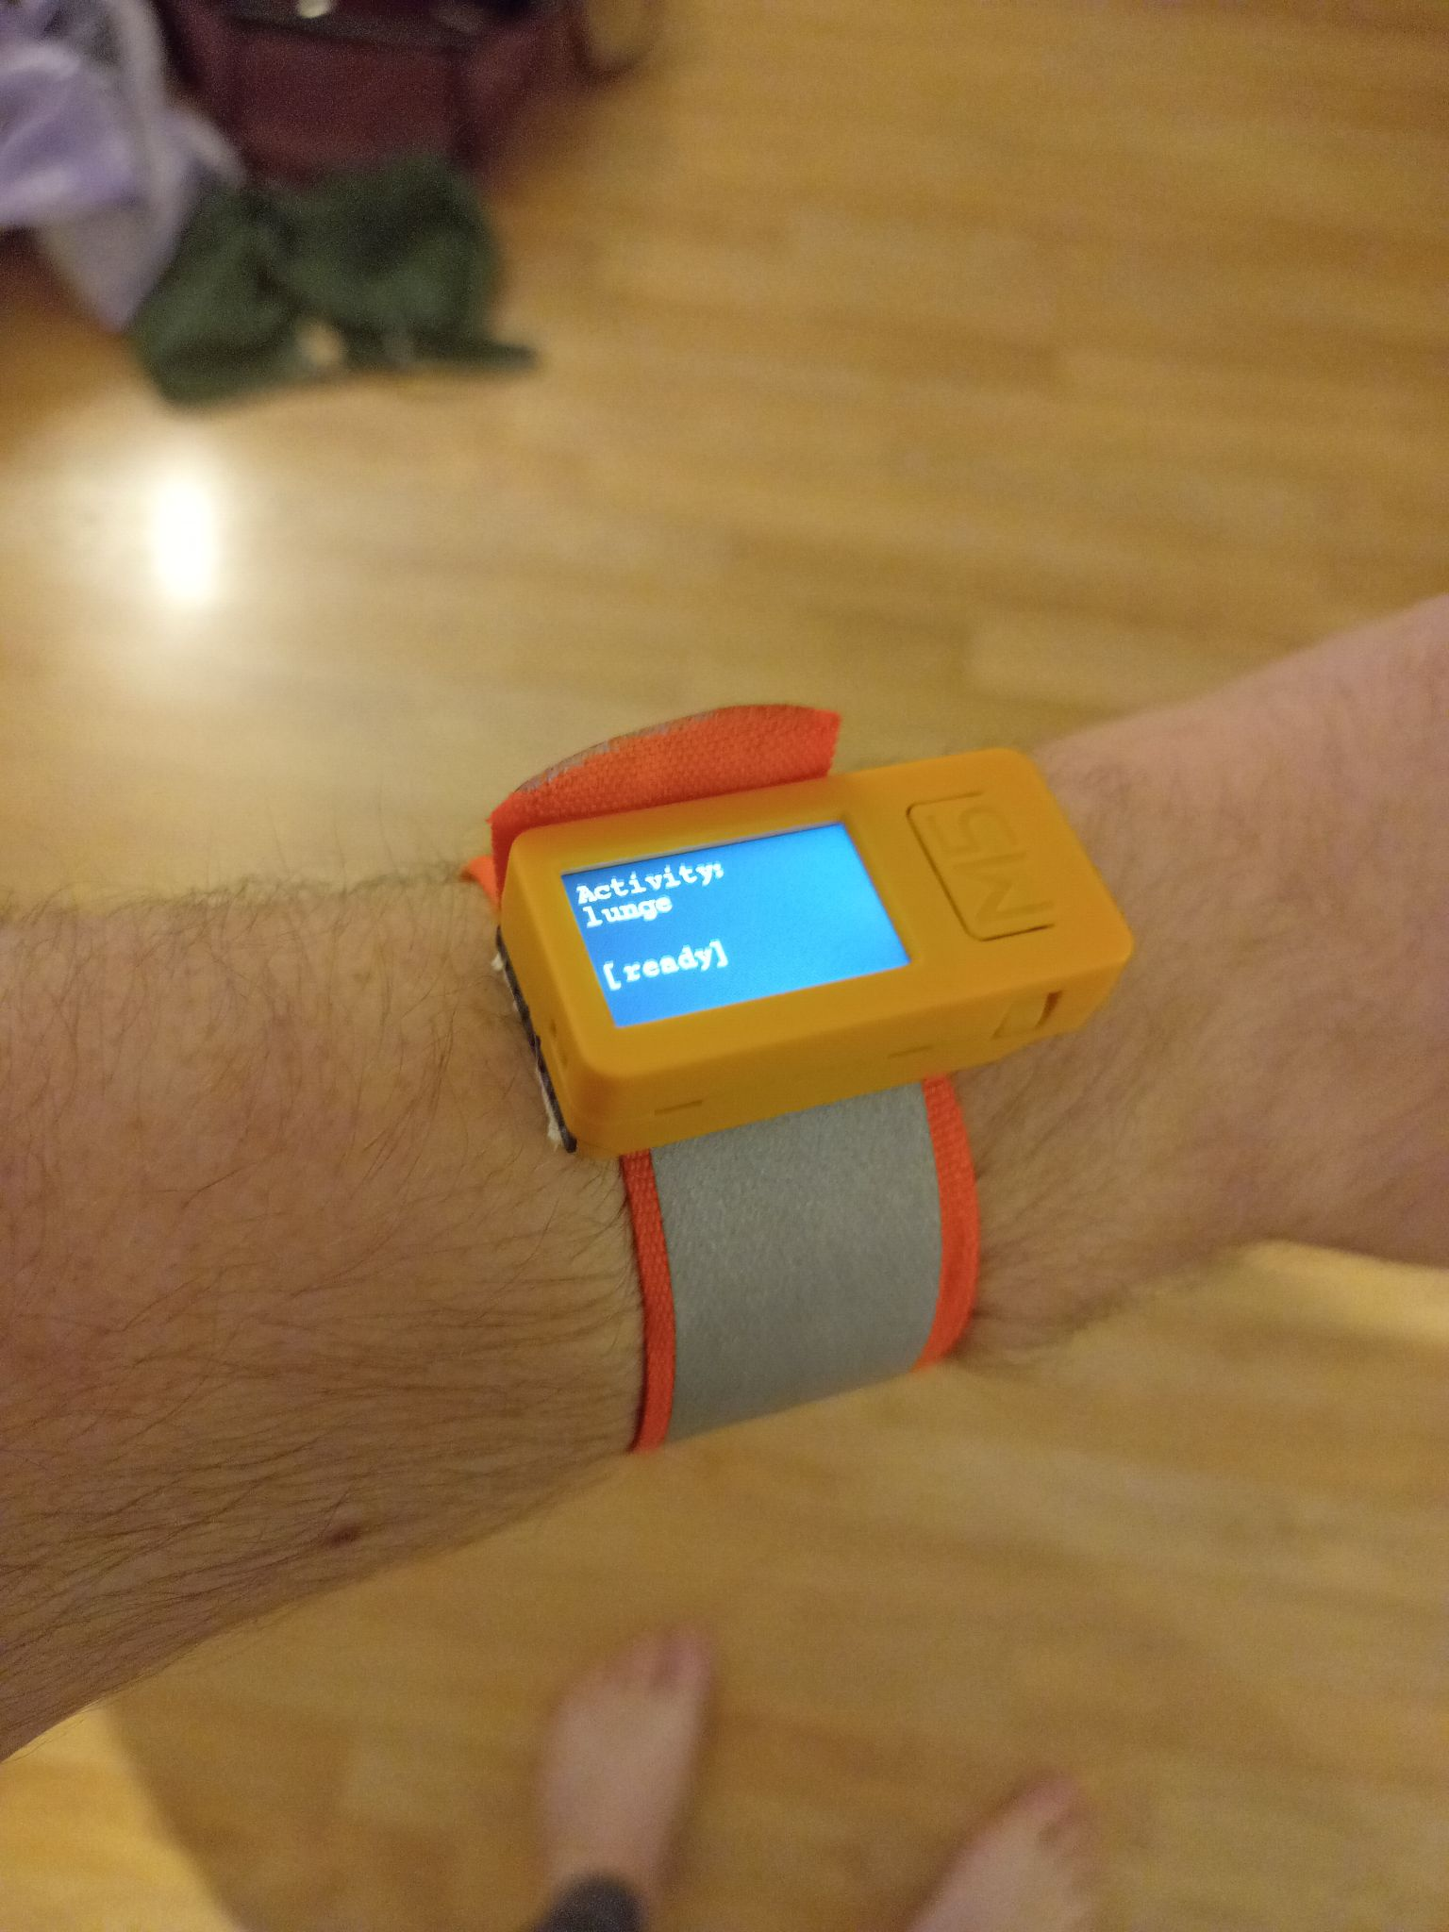
Recording a dataset with “pre-labeling”
Controlled data collection
Activity to perform indicated up-front
Save files to internal file system (.CSV/.NPY) Transfer to PC over USB
File system
https://docs.zephyrproject.org/ latest/samples/subsys/fs/fs_sample/README.html#fs
USB Mass Storage https://docs.zephyrproject.org/latest/samples/subsys/usb/mass/README.html#usb-mass
Alt: SMP server + smpclient (serial/BLE)
https://docs.zephyrproject.org/latest/samples/subsys/mgmt/mcumgr/smp_svr/README.html#smp-svr-sample-build

Slide 19
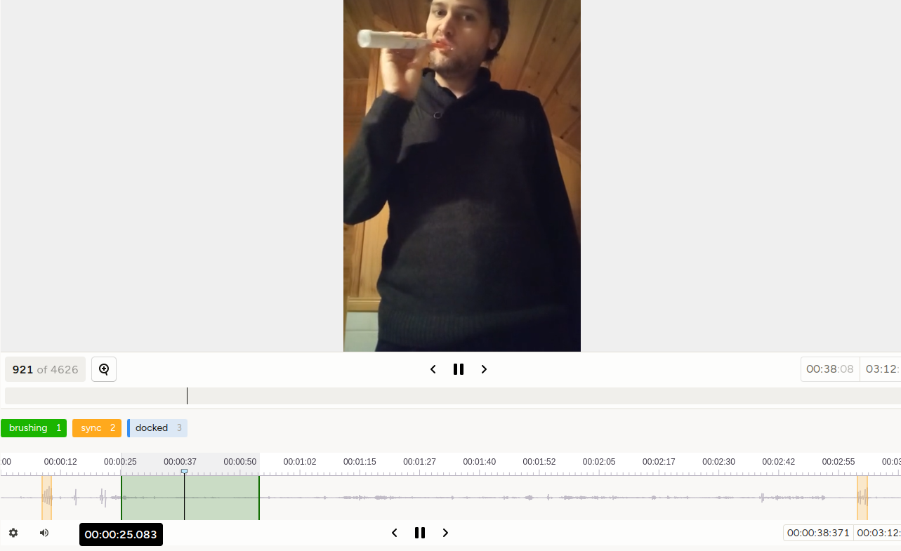

Better labeling
Video recorded on phone used as reference for labeling
Start/end marked by tapping device - used to sync video/labels from phone with sensor data
Use Label Studio for labeling
https://labelstud.io/ templates/timeseries_audio_video Supports time-series + video
Data collection tools: https://github.com/emlearn/emlearn-micropython/tree/master/examples/har_trees

Slide 20
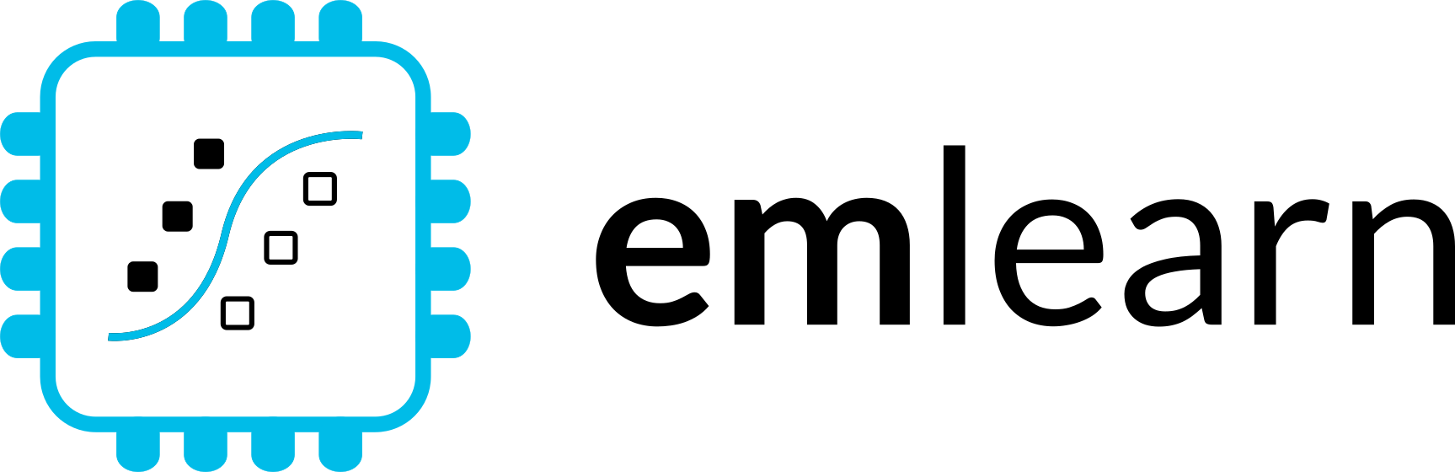
Training
model

Slide 21
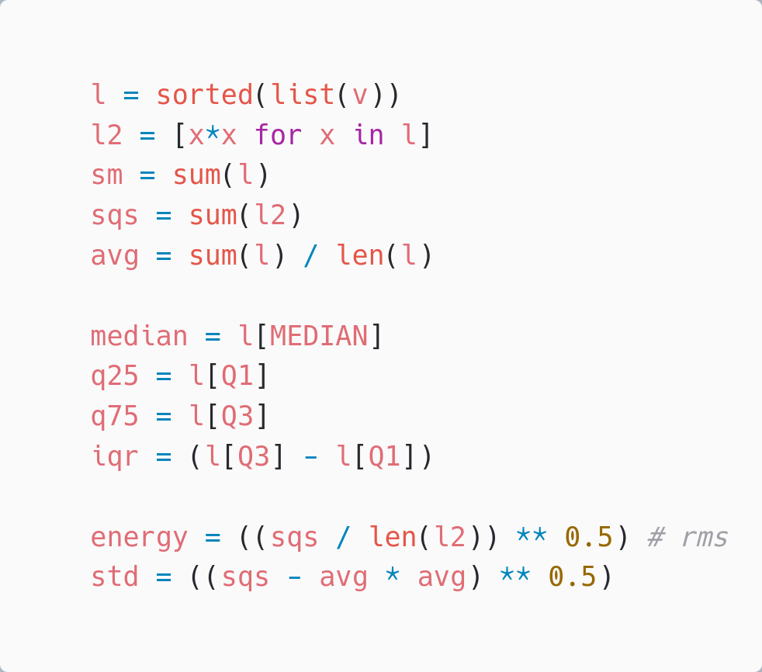
Preprocessing for Activity Recognition
Gravity separation (simple)
Low-pass to separate gravity vector
Motion = Acceleration - Gravity
Feature extraction
Basic statistical summarizations are very useful. Can be sufficient for Human Activity Recognition
Practical example https://github.com/emlearn/emlearn/issues/108
Time-based features extraction Are Microcontrollers Ready for Deep Learning-Based Human Activity Recognition?
Atis Elsts, and Ryan McConville
https://www.mdpi.com/2079-9292/10/21/2640

Slide 22
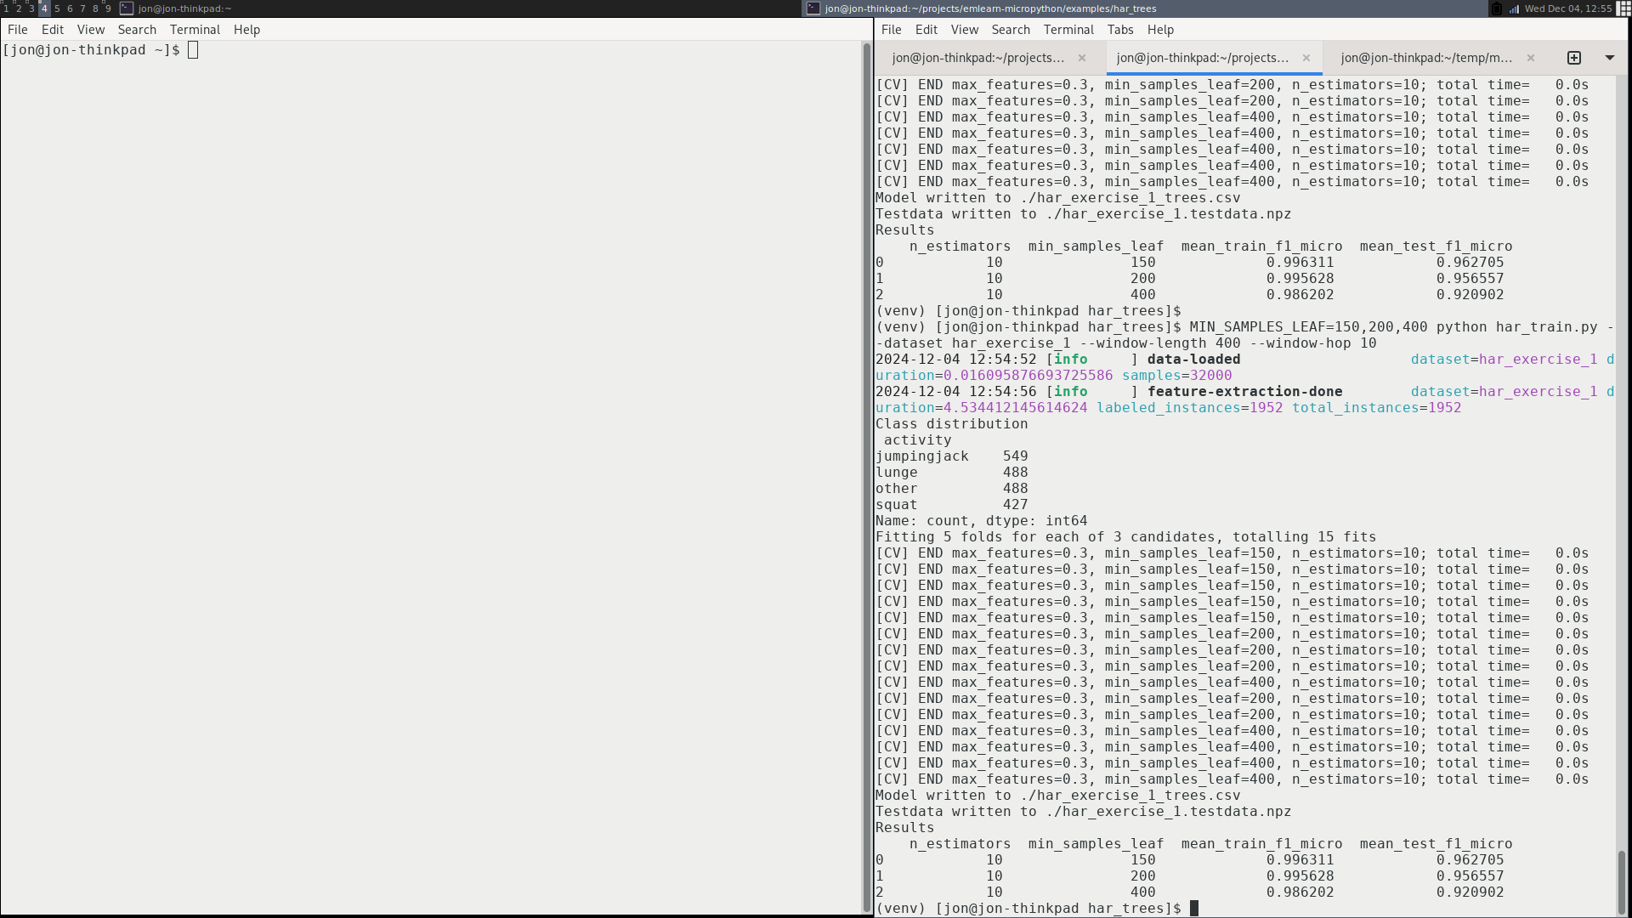


Training model on dataset
Using a scikit-learn based pipeline.
# Setup subject-based cross validation
splitter = GroupShuffleSplit(n_splits=n_splits, test_size=0.25,
random_state=random_state)
# Random Forest classifier
clf = RandomForestClassifier(random_state = random_state,
n_jobs=1, class_weight = "balanced")
# Hyper-parameter search
search = GridSearchCV(clf, param_grid=hyperparameters,
scoring=metric, refit=metric, cv=splitter)
search.fit(X, Y, groups=groups)
har_train.py https://github.com/emlearn/emlearn-micropython/ blob/master/examples/har_trees/har_train.py

Slide 23
Deploying model

Slide 24
Export model with emlearn
Install Python package
$ pip install emlearn
mynet_model.h
#include <eml_net.h>
static const float mynet_layer_0_biases[8] = { -0.015587f, -0.005395f, -0.010957f, 0.015883f ….
static const float mynet_layer_0_weights[24] = { -0.256981f, 0.041887f, 0.063659f, 0.011013f, …
static const float mynet_layer_1_biases[4] = { 0.001242f, 0.010440f, -0.005309f, -0.006540f };
static const float mynet_layer_1_weights[32] = { -0.577215f, -0.674633f, -0.376140f, 0.646900f, …
static float mynet_buf1[8];
static float mynet_buf2[8];
static const EmlNetLayer mynet_layers[2] = {
{ 8, 3, mynet_layer_0_weights, mynet_layer_0_biases, EmlNetActivationRelu },
{ 4, 8, mynet_layer_1_weights, mynet_layer_1_biases, EmlNetActivationSoftmax }
};
static EmlNet mynet = { 2, mynet_layers, mynet_buf1, mynet_buf2, 8 };
int32_t
mynet_predict(const float *features, int32_t n_features)
{
return eml_net_predict(&mynet, features, n_features);
}
………
import emlearn
cmodel = emlearn.convert(model, method='inline')
cmodel.save(file=mynet_model.h', name='mynet')
Use emlearn.convert() and .save()
Example of generated code
Notes:
Training a model is done using a standard framework like scikit-learn or keras.
You will need to already have a dataset collected and labeled for your task.
There is nothing emlearn specific at this point
- although you should use a model small enough to fit on your target device.
We also provide some tools for checking this.
Once you have a trained model, you are ready to deploy it to the device.

Slide 25
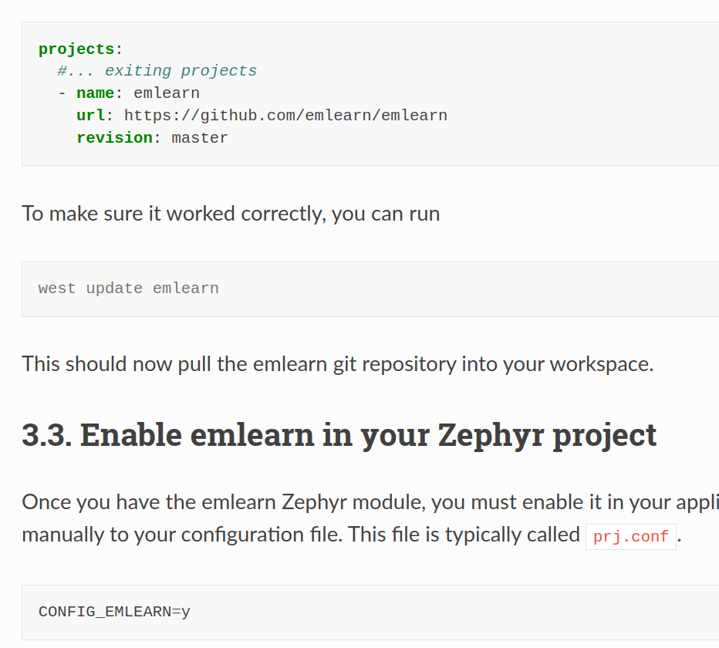
emlearn module for Zephyr
Add project to west.yml
Enable in your project
Use in your code #include <eml_net.h> #include “my_model.h”
Module exists since February 2024
emlearn documentation
https://emlearn.readthedocs.io/en/latest/ getting_started_zephyr.html
Zephyr documentation
https://docs.zephyrproject.org/ latest/develop/manifest/external/emlearn.html
Notes:
STM32, Nordic NRF5x, ESP32, RP2040

Slide 26
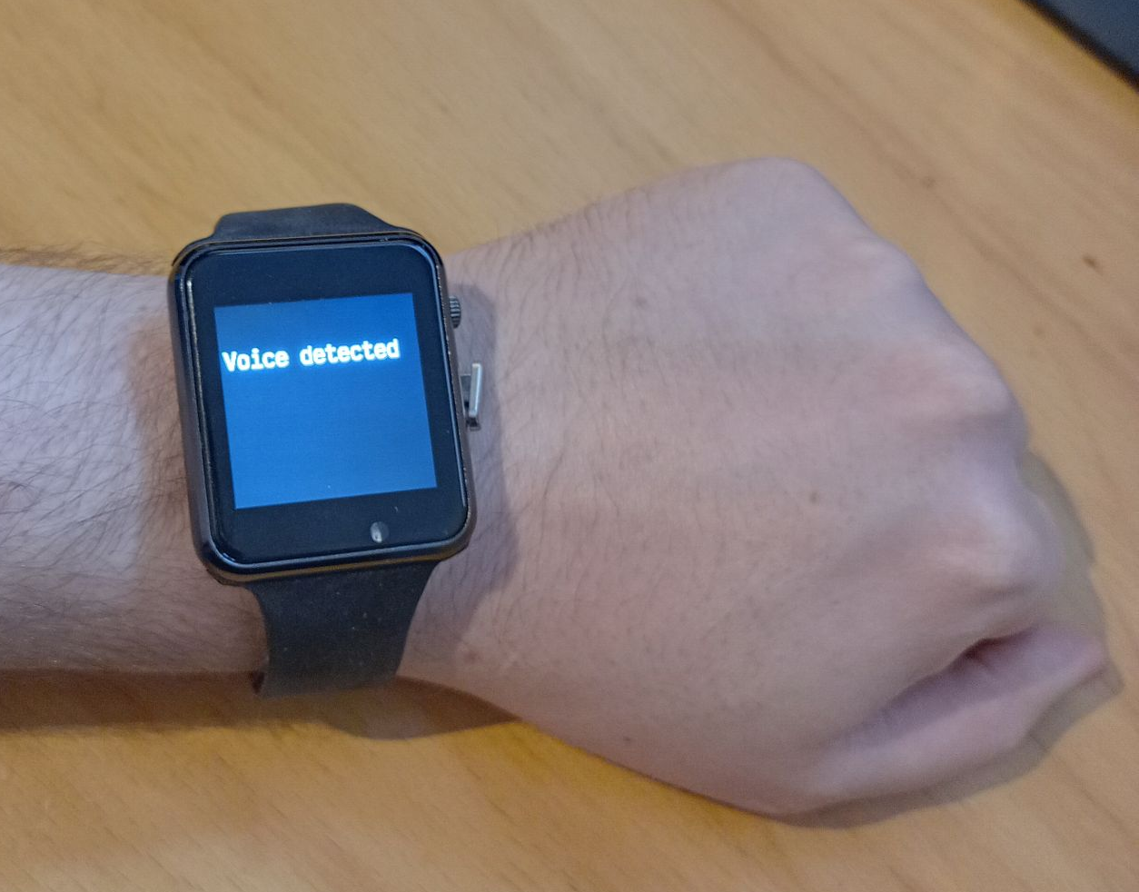
Using the C code
3. #include and call predict()
// Include the generated model code
#include "mynet_model.h"
// index for the class we are detecting
#define MYNET_VOICE 1
// Buffers for input data
#define N_FEATURES 6
float features[N_FEATURES];
#define DATA_LENGTH 128
int16_t sensor_data[DATA_LENGTH];
// Get data and pre-process it
read_microphone(sensor_data, DATA_LENGTH);
preprocess_data(sensor_data, features);
// Run the model
out = mynet_predict(features, N_FEATURES);
// Do something with results
if (out == MYNET_VOICE) {
set_display("voice detected");
} else {
set_display("");
}
setup
loop
Notes:
To use the code, include the generated header file.
Pass the data to the predict() call of the model.
The output can the be used to trigger relevant actions,
such as controlling motors, logging event that occur,
or sent an external system.
In this example, we just show the model output on a display.

Slide 27
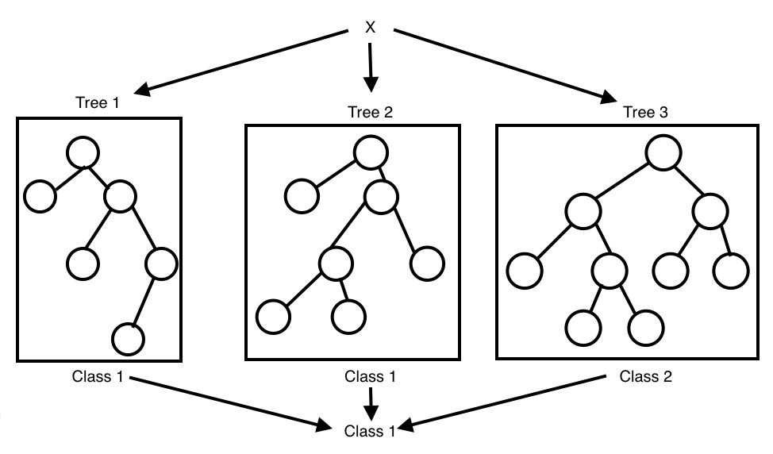
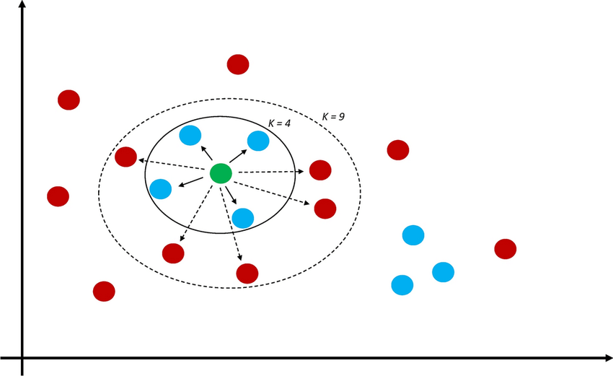
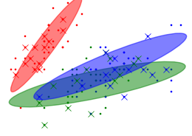
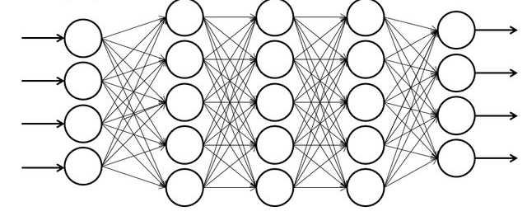
Supported models
Selection of simple & effective embedded-friendly models
Decision Trees (DT)
Random Forest (RF)
K Nearest Neighbors (KNN)
Gaussian Mixture Models (GMM)
Multi-Layer-Perceptron (MLP)
Convolutional Neural Network (CNN)
Notes:
Supports a selection of embedded friendly models:
….

Slide 28
Validating model

Slide 29
Sensor data analysis with Machine Learning
1) Read sensors –> 2) Process data * –> 3) Transmit/act
Notes:
When it comes to Machine Learning on microcontrollers,
we are obviously not going to be running any Large Language Models or generative image models.
But one usecase where ML is incredibly useful is in analysing sensor data.
Sensors such as accelerometers, microphonones, radars, and cameras have gotten incredibly cheap and powerful.
But in order to get useful information out of these, the raw data must be processed.
Using Machine Learning, in combination with Digital Signal Processing, allows analyzing complex phenomena.
If this is done on the microcontroller, we get a range of benefits:
...
The component in blue is the Machine Learning model, and is typically trained ahead of time on a PC.

Slide 30
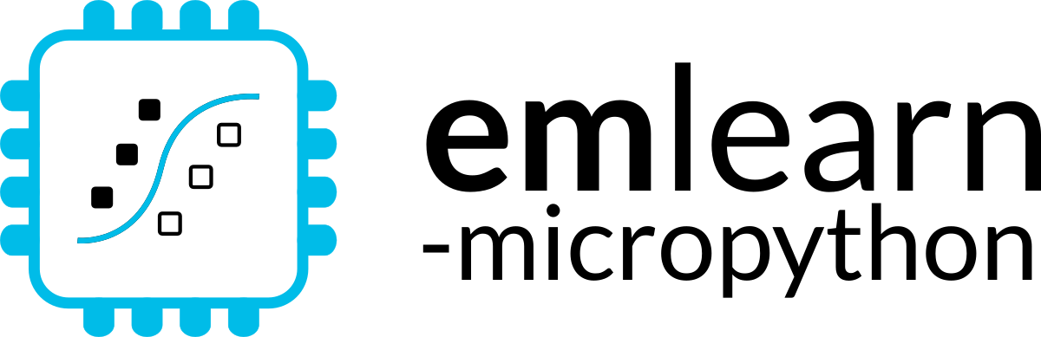

Bridging the TinyML language gap
Python is the lingua franca for Machine Learning How can we enable people to build TinyML solution also using Python?
with MicroPython

Slide 31
MicroPython - Introduction
Implements a subset of Python 3.x
For devices with 64 kB+ RAM
Supports using Zephyr as HAL
Has matured a lot in MicroPython 1.26 (August 2025)
More testing & contributors wanted!
More info: https://micropython.org
Notes:
STM32, Nordic NRF5x, ESP32, RP2040

Slide 32
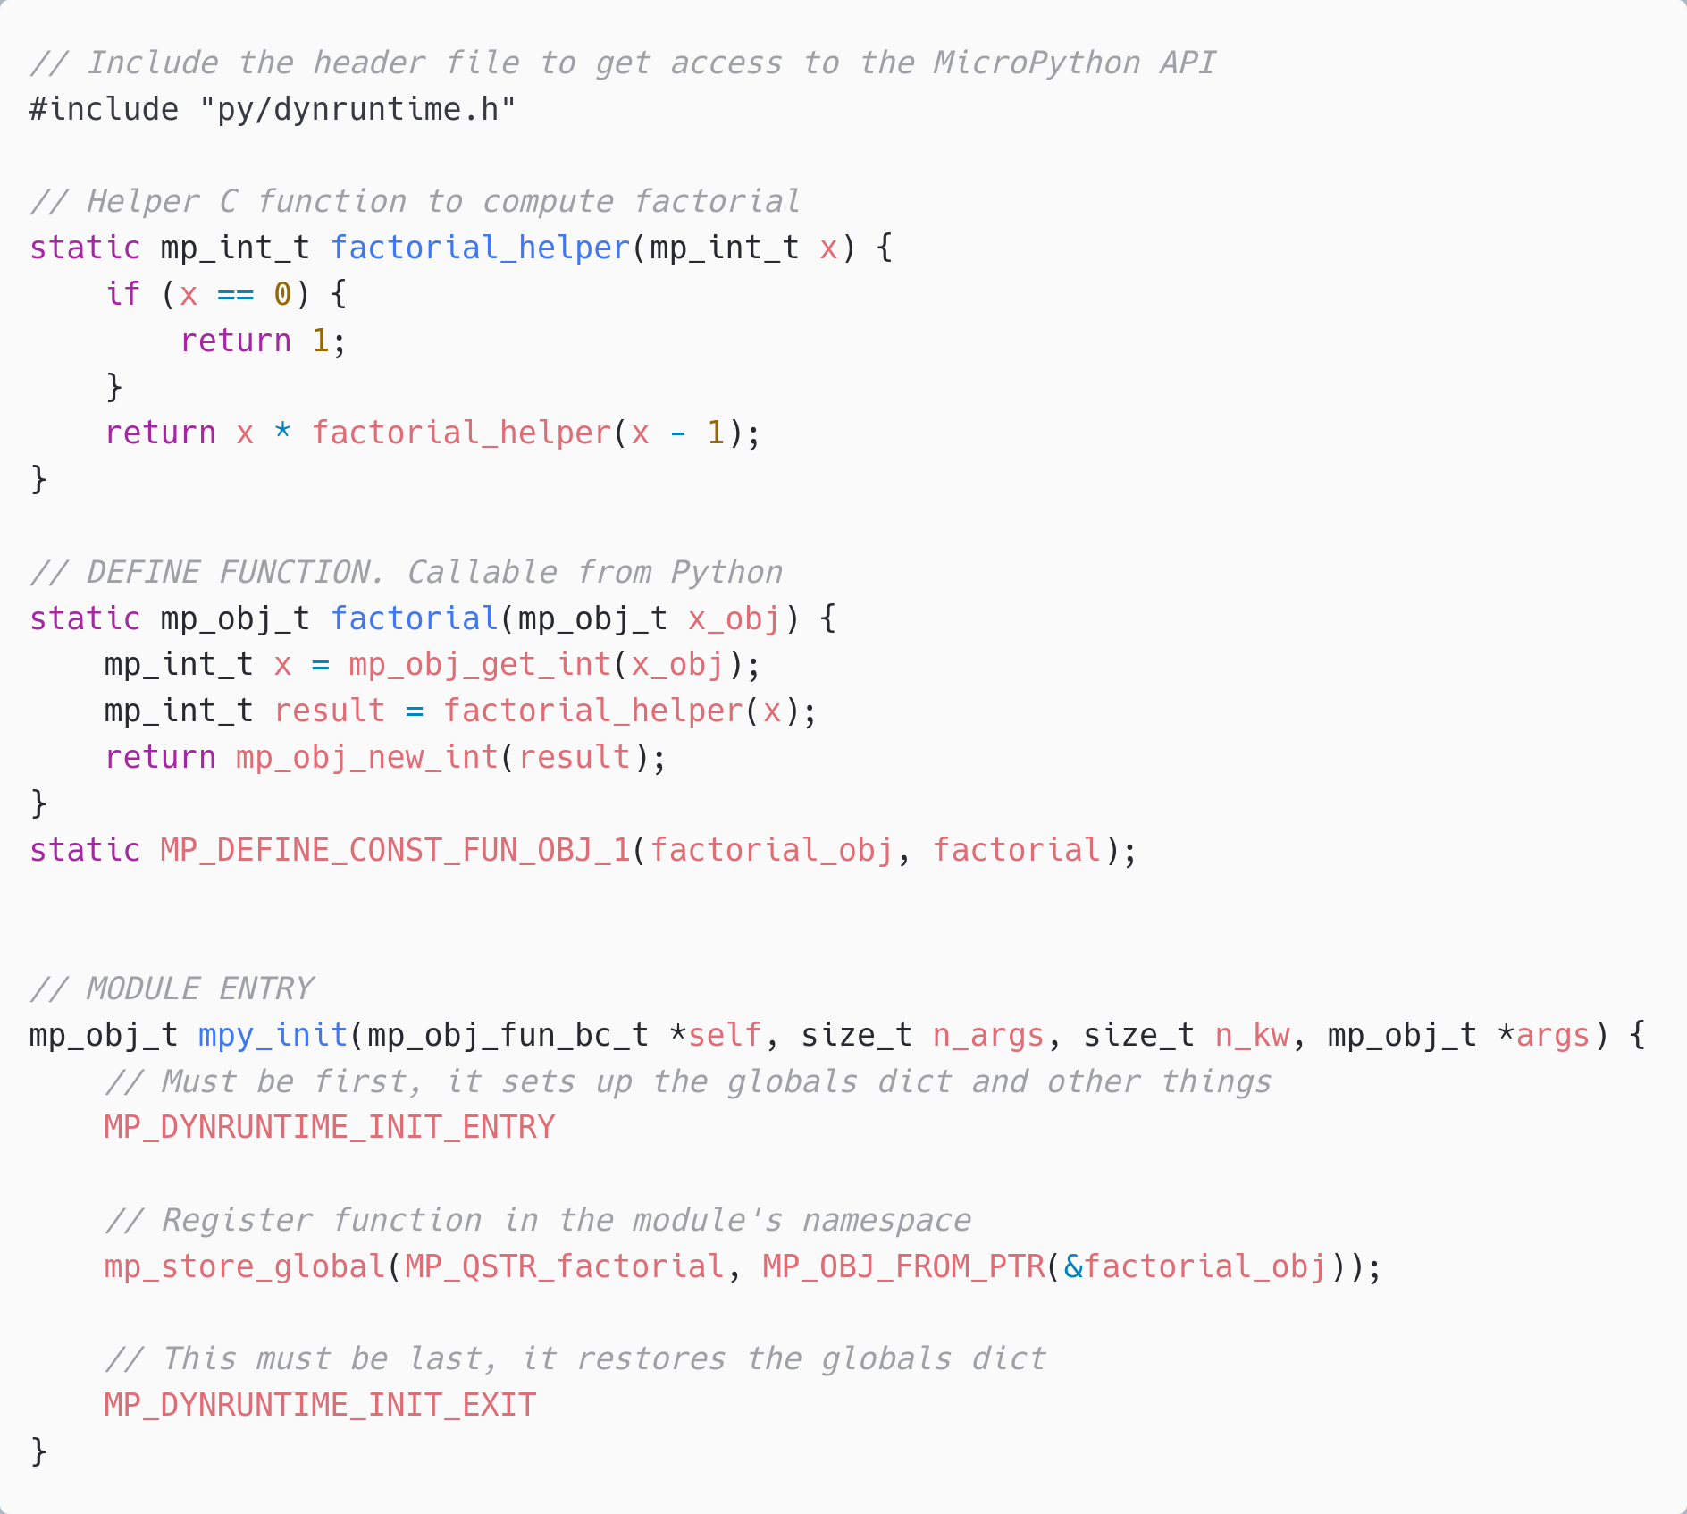
C modules *
Defines a Python module with API. functions/classes et.c.
Implemented by users, libraries, or part of MicroPython core.
Can be portable or hardware/platform specific
* Or other language which compiles to C, or exposes a C API. C++, Rust, et.c.

Slide 33
MicroPython Data Science ecosystem
CPython
MicroPython
Tensorflow
scikit-learn
emlearn-micropython
github.com/emlearn/emlearn-micropython
OpenCV
OpenMV
https://openmv.io/
scipy
ulab
github.com/v923z/micropython-ulab
numpy
Libraries existing that implement a lot of embedded-relevant functionality from PyData stack.

Slide 34
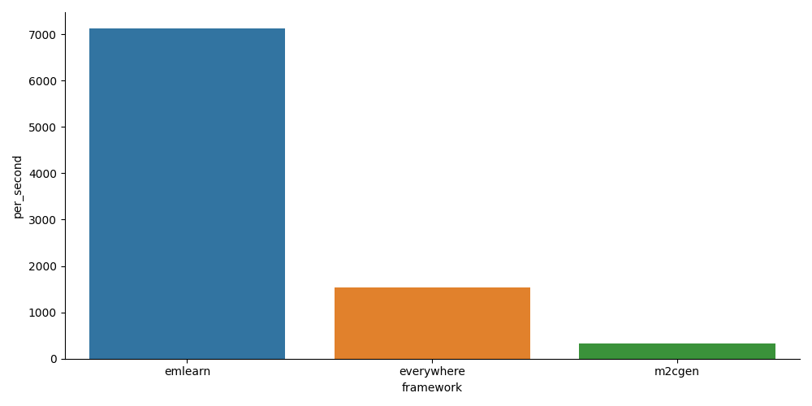
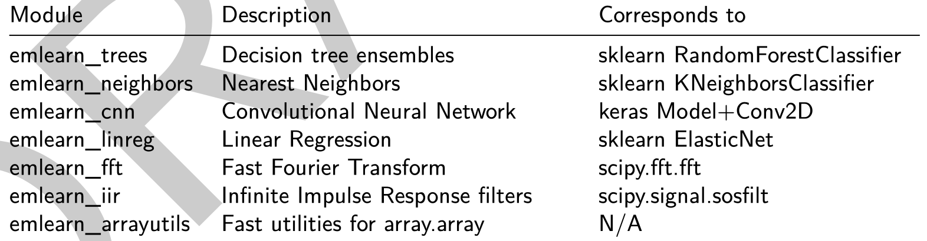
emlearn-micropython: MicroPython bindings for emlearn
https://github.com/emlearn/emlearn-micropython/
5x - 20x faster than plain Python
Modules installable at runtime (.mpy)
1 - 10 kB in size

Slide 35
Install & Export model
import emlearn
estimator = train_model()
converted = emlearn.convert(estimator)
converted.save(name='gesture', format=’csv’, file='gesture_model.csv')
Export model on PC
Copy model to device
mpremote fs cp gesture_model.csv :
Prebuilt binary No need to setup C toolchain and SDK
Copy library to device
mpremote mip install https://emlearn.github.io/...../xtensawin_6.2/emltrees.mpy

Slide 36
Load model & run
import emltrees
# Instantiate model. Capacity for trees, decision nodes, classes
model = emltrees.new(20, 200, 10)
# Load model "weights"
with open('gesture_model.csv') as f:
emltrees.load_model(model, f)
Load model on device
# Read sensor data
sensor.fifo_read(samples)
# Preprocess features
preprocessor.run(samples, features)
# Run model
out = model.predict(features)
Run inference

Slide 37
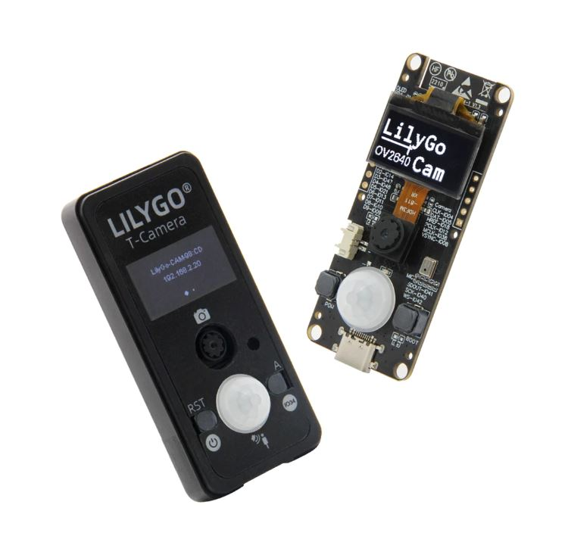
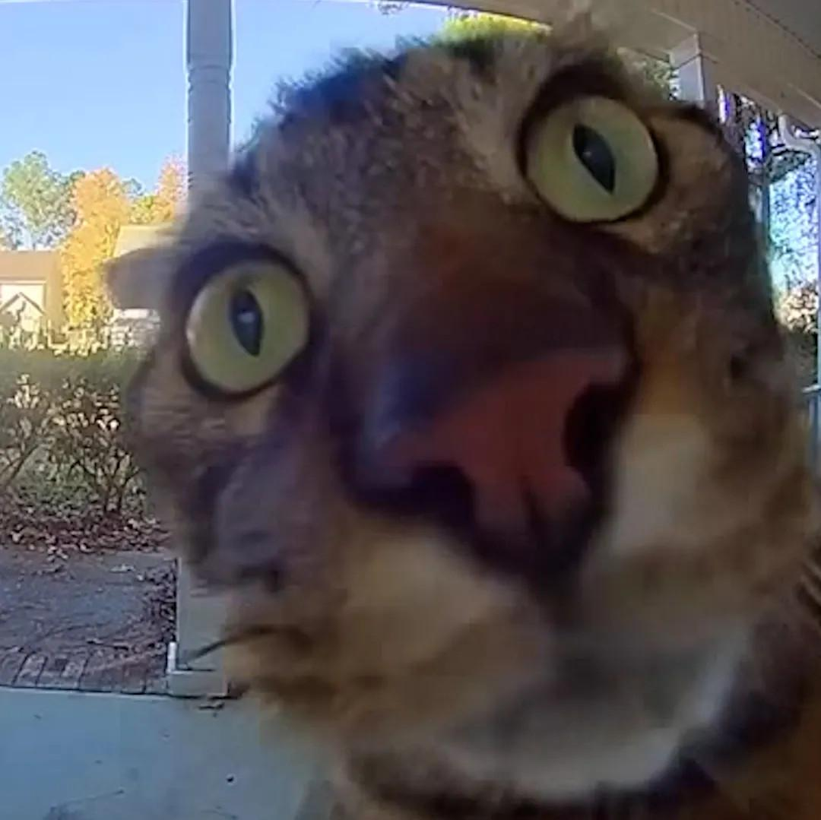
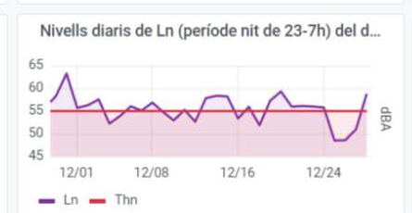
Activity tracker
Noise monitor
Image
Classifier
Accelerometer
Microphone
Camera
Examples at
https://github.com /emlearn/emlearn-micropython #examples
if is_MyCat(img): open_door()
Random Forest classifier emlearn_trees
Infinite Impulse Response filters emlearn_iir
Convolutional Neural Network emlearn_cnn

Slide 38
Outro

Slide 39
Summary
Machine learning inference on microcontroller useful in many applications
Zephyr is a good base
Sensor API, filesystem, connectivity
emlearn makes deploying models simple
Converting scikit-learn or Keras to efficient C code
Easy to use via Zephyr module
Bonus: MicroPython can also be used with Zephyr and emlearn-micropython
Notes:
As a brief structure of this presentation

Slide 40
More resources
Official documentation
https://emlearn-micropython.readthedocs.io https://emlearn.readthedocs.io
TinyML EMEA 2024: emlearn - scikit-learn for microcontrollers and embedded systems https://www.youtube.com/watch?v=LyO5k1VMdOQ FOSDEM 2025: Milliwatt sized Machine Learning on microcontrollers with emlearn https://fosdem.org/2025/schedule/event/fosdem-2025-4524-milliwatt-sized-machine-learning-on-microcontrollers-with-emlearn/
FOSDEM 2025: MicroPython - Python for microcontrollers and Embedded Linux https://fosdem.org/2025/schedule/event/fosdem-2025-4525-micropython-python-for-microcontrollers-and-embedded-linux/
Notes:
Microcontroller is a small programmable chip.
That since the last 20 years provides the “brain” of basically any electronics device around us.
All the devices that you have in your home have 1 or more microcontrollers each.
A modern car has over 50 microcontrollers.
While they are mostly used for industrial application, they are increasingly accessible for hobbyists and semi-professionals. And today many of these devices can run Python! So in a way, you probably already know how to program them.

Slide 41
Machine Learning for Microcontrollers
with Zephyr and emlearn
https://github.com/emlearn/emlearn
Jon Nordby jononor@gmail.com
August 2025, Amsterdam

Slide 42
Bonus

Slide 43
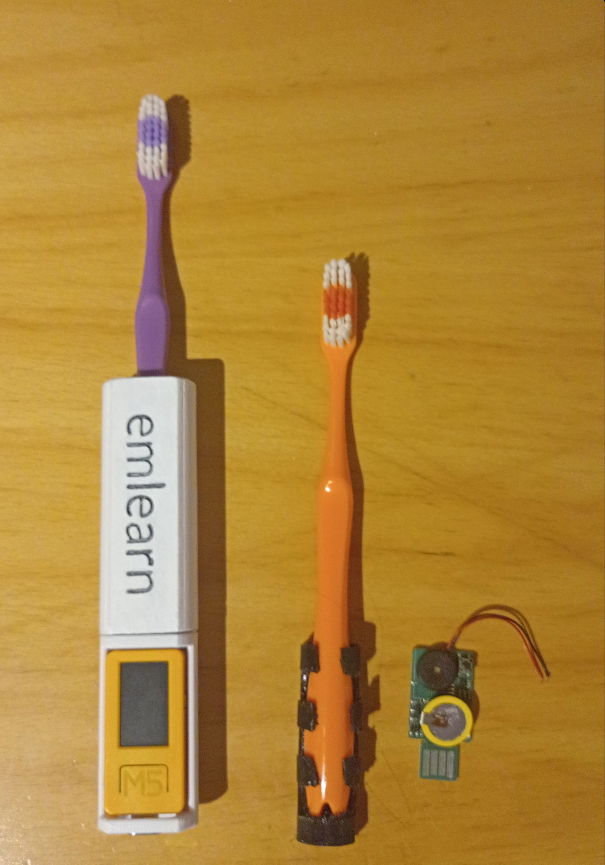

Potential Improvements
Easier install (no zipties)
Reduce size
Reduce costs
Flexible TPU casing
Custom PCB Puya PY32 - 8 kB RAM / 64 kB FLASH
Using emlearn C library
https://hackaday.io/project/ 194511-1-dollar-tinyml

Slide 44
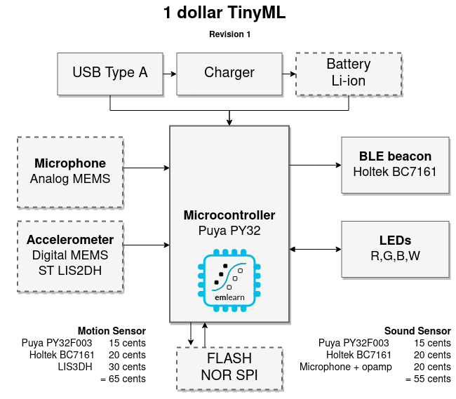
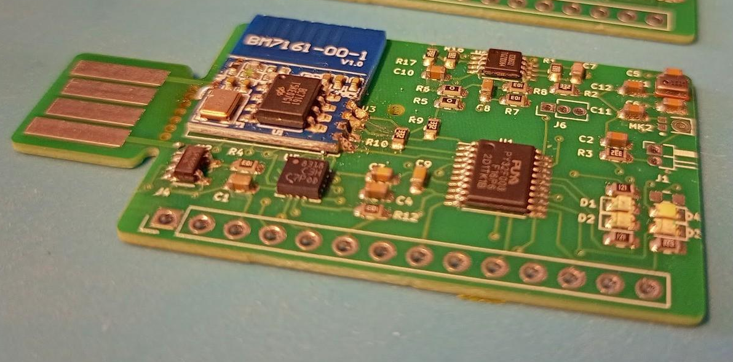
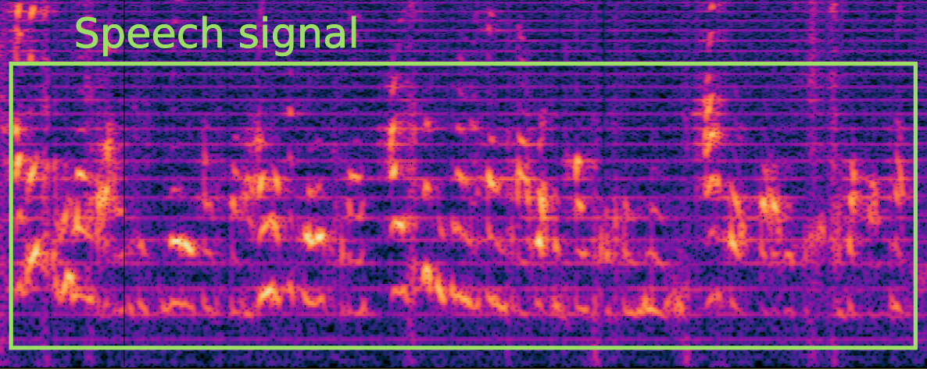
1 dollar TinyML
https://hackaday.io/project/194511-1-dollar-tinyml
Research question: Can we make a useful TinyML system <1 USD in total component cost (BOM)?
Preliminary answer: YES! Either motion (accelerometer) or sound sensor (microphone)
Constraints: 8 kB RAM / 64 kB FLASH
Current status: Audio streaming works Revision 2 ordered
A)
B)
Notes:
### Object detection

Slide 45
Task feasibility versus microcontroller type
 | RAM (kB) | FLASH (kB) | CPU (CoreMark) |  | IMU 100 hz 5 s | Sound 16 kHz 1 s | Image 64x64 px 1 fps
Arduino Uno ATMega 328 @ 16 Mhz | 2 | 32 | 4.0 |  | ✓ | ❌ | ❌
Arduino Nano BLE 33 NRF52840 ARM Cortex M4F @ 64 Mhz | 256 | 1 000 | 215 |  | ✓ | ✓ | ❌
Arduino Nano ESP32 ESP32-S3 @ 240 Mhz | 8 000 | 16 000 | 613 (per core) |  | ✓ | ✓ | ✓
Teensy 4.0 ARM Cortex M7 @ 600 Mhz | 1 000 | 2 000 | 2313 (per core) |  | ✓ | ✓ | ✓
Notes:
Coremark Mega 7.03 https://github.com/PaulStoffregen/CoreMark https://www.eembc.org/coremark/scores.php
Accelerometers/IMU 100-1kHz. Every N seconds. Human Activity Detection Basically anything ?
Sound
Typ 16 khz. Not 48 kHz
Specialized detectors. 1-100 classes
Image/video.
Low resolution, low framerate.
Specialized detectors. 1-10 classes. Not ImageNet Classification and object detection. Edge Impulse FOMO OpenMV
https://docs.edgeimpulse.com/docs/edge-impulse-studio/learning-blocks/object-detection/fomo-object-detection-for-constrained-devices

Slide 46
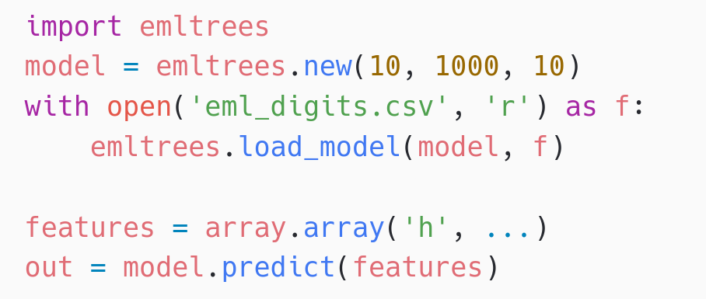
Human Activity Detection with emlearn_trees
Using Random Forest classifier trained with scikit-learn
Performance comparison
10 trees, max 100 leaf nodes, “digits” dataset
Inference time Program space
m2cgen 60.1 ms 179 kB everywhereml 17.7 ms 154 kB
emlearn 1.3 ms 15 kB
https://github.com/emlearn/emlearn-micropython /tree/master/examples/har_trees
emlearn is 10x faster and 10x more space efficient compared to generating Python code

Slide 47
Activity Tracker - Feature Extraction
Statistical summarizations are useful time-series features, sufficient for basic Human Activity Recognition.
! Preprocessing must be compatible between training on host PC (CPython) and device (MicroPython)
Solution: Write preprocessor for MicroPython, re-use in Python
subprocess(‘micropython preprocess.py data.npy features.npy’)
Alternative: (when using common MicroPython/CPython subset)
import mypreprocessor.py
Using micropython-npyfile to read/write Numpy .npy files https://github.com/jonnor/micropython-npyfile/
https://github.com/emlearn/emlearn-micropython/blob/master/examples/har_trees/timebased.py
Time-based features extraction Are Microcontrollers Ready for Deep Learning-Based Human Activity Recognition?
Atis Elsts, and Ryan McConville
https://www.mdpi.com/2079-9292/10/21/2640

Slide 48
Tree-based ensembles
Random Forest / Decision Tree
The most popular model in emlearn

Slide 49
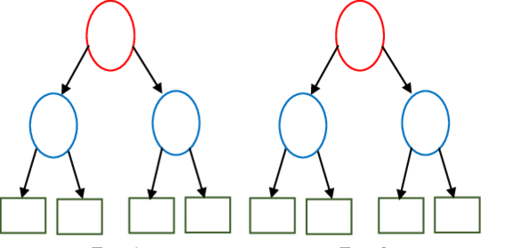
emlearn trees: Leaf compression
scikit-learn decision trees store class probabilities in leaf-nodes. Size: n_leaves * n_classes * 4 bytes
Consequence: Leaves take a large amount of space
emlearn (since 2019) does hard majority voting instead
And does leaf-node de-duplication across all trees
Size: n_classes * 1 * 1 byte
Saving 50-80% of space
Tradeoff: May read to reduced predictive performance with some leaf values
0.0 | 1.0 | 0.0 | 0.0
1
Lossless
0.0 | 0.0 | 1.0 | 0.0
2
0.0 | 0.4 | 0.6 | 0.0
Not ideal
0.15 | 0.20 | 0.30 | 0.15
………
Notes:
Inline and loadable (data structure) Majority voting instead of class probabilities Leaf-node de-duplication

Slide 50
emlearn trees: Inference modes
Data structure (“loadable”)
Can be loaded at runtime
Only supports float
Code generation (“inline”)
Supports int8/int16/int32 and float
static const EmlTreesNode xor_model_nodes[14] = {
{ 1, 0.197349f, 1, 2 },
.........
{ 0, 0.421164f, -2, -1 }
};
EmlTrees xor_model = { 14, xor_model_nodes, …… };
static int32_t
eml_trees_predict_tree(const EmlTrees *f, int32_t tree_root,
const float *features, int8_t features_length) {
int32_t n = tree_root;
while (n >= 0) {
const float value = f[forest->nodes[node_idx].feature];
const float point = forest->nodes[node_idx].value;
const int16_t child = (value < point) ? f->nodes[n].left : f->nodes[n].right;
…..
}
return leaf;
}
static inline int32_t xor_model_tree_0(const float *features, int32_t features_length)
{
if (features[1] < 0.197349f) {
if (features[0] < 0.466316f) {
return 0;
} else {
return 1;
}
} else {
if (features[1] < 0.256702f) {
if (features[0] < 0.464752f) {
return 0;
} else {
return 1;
}
} else {
....
}
Notes:
16 bit integer features instead of 32 bit floats Reduced
Class probability leaves with clustering K-means

Slide 51
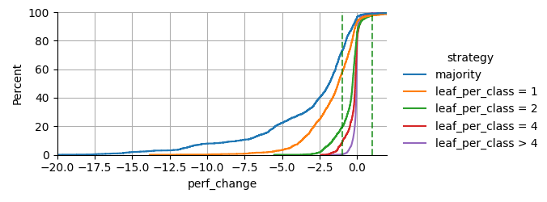
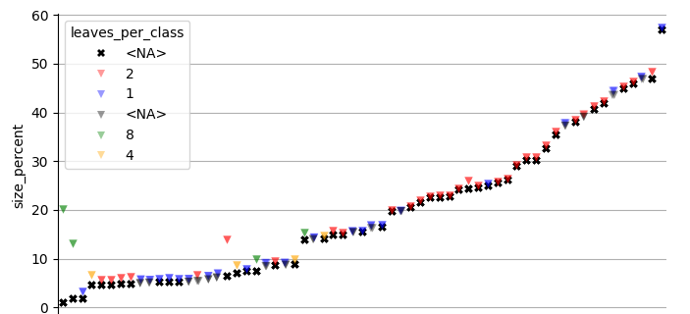
emlearn trees: K-means clustering for leaf de-duplication
Optimizing for: Small model size
Constraint: Under 1 percentage point drop in AUC ROC
Evaluating on 48 datasets from OpenML CC18 suite
Preliminary results - paper to follow
Hard majority sometimes bad:
Failed perf constraint on
75% of datasets
Clustering with N leaves per class Allows adaptable size/perf tradeoff
2-8 leaves per class sufficient 0% of datasets failed performance constraint
High model size compression 50-90%
Notes:
Inline and loadable (data structure) Majority voting instead of class probabilities Leaf-node de-duplication

Slide 52



Trees - relevant across the task complexity range
Low Go-to for tabular data
Very easy to get good performance, with minimal tweaking.
Medium Alternative to deep learning
Elsts et.al [1] showed performance matching a deep-learning approach,
at 10x to 100x better resource usage
High Combine with neural network Daghero et.al [2] showed up to 67.7% energy saving using two-stage approach
1. “Are Microcontrollers Ready for Deep Learning-Based Human Activity Recognition?” Atis Elsts, Ryan McConville (2021) https://www.mdpi.com/2079-9292/10/21/2640
2. “Two-stage Human Activity Recognition on Microcontrollers with Decision Trees and CNNs”. Francesco Daghero, Daniele Jahier Pagliari, Massimo Poncino (2022) https://arxiv.org/abs/2206.07652 3. “Energy Efficiency of Inference Algorithms for Clinical Laboratory Data Sets: Green Artificial Intelligence Study”
Jia-Ruei Yu et. al (2022) https://www.jmir.org/2022/1/e28036/
Notes:
The project was started in 2018 by me.
And has been maintained by me since that time. With a couple of contributors here and there. Quite mature. Has been used for dozens of projects across the world.

Slide 53
Focus of this presentation
TinyML development phases
ML pipeline
- Task definition
- Hardware bringup
- Data collection
- Exploratory Data Analysis
- Data annotation/curation
- Model pipeline setup
- Iterating. Model and dataset
- Lab/field testing
- Monitoring in production
- Data reading/loading
- Pre-processing
- Machine Learning model (inference/training)
- Post-processing
- Acting on outputs

Slide 54




Act locally
Task: Give vaccinated bait only to Tasmanian devils
Trigger: PIR sensor
Wake up
Classify image using CNN if is_Taz: dispense_bait()
Send event over LoRaWAN
EdgeAI bait dispenser to vaccinate the Tasmanian devil (Sarcophilus harrisii) against the devil facial tumour disease Prithul Chaturvedi¹, Andrew S. Flies, et al.
Notes:
Make it moving again and again (loop it)

Slide 55


MicroPython - Installing
Download prebuilt firmware https://micropython.org/download/?port=esp32
Flash firmware to device
pip install esptool
esptool.py --chip esp32 --port … erase_flash
esptool.py --chip esp32 --port … write_flash -z 0 micropython-v1.17.bin
Connect to device
pip install mpremote mpremote repl
IDE (optional): Thonny, VS Code, et.c.
Notes:
! drives for peripherals that are on a board not included in core firmware
Will likely need to hunt a bit for each sensor, screen etc

Slide 56
MicroPython is Python - but not CPython
High degree of compatibility - but never 100% Continuous job to keep up with CPython Some differences inherent - from < 1 MB RAM and FLASH Included libraries are minimal micropython-lib has more extensive/featured https://github.com/micropython/micropython-lib
Known incompatibilities https://docs.micropython.org/en/latest/genrst/index.html #micropython-differences-from-cpython Not implemented (by CPython major release) https://github.com/micropython/micropython/issues/ 7919#issuecomment-1025221807
No CFFI or C module compatibility! But there is another C API
=> No standard PyData stack
But there are alternatives
Notes:
Temperature is a slow changing phenomena. Want: 1 value for longish time interval (ex: 5 min)
! Sensor can be noisy. Filtering advised
Will show analog sensor example. Same approach can be used for a digital sensor. And for other slow-changing phenomena.

Slide 57


Hardware access - the machine module
https://docs.micropython.org/en/latest/library/machine.html
Hardware Abstraction Layer for microcontroller peripherals
Same on all hardware/ports * with exceptions

Slide 58





Connectivity
WiFi network.WLAN Ethernet network.LAN
BLE - Bluetooth Low Energy aioble - high-level application API, asyncio bluetooth - low-level hardware-layer
Cellular (4G / LTE) network.PPP LoRa / LoRaWAN micropython-lib: lora
Notes:
Temperature is a slow changing phenomena. Want: 1 value for longish time interval (ex: 5 min)
! Sensor can be noisy. Filtering advised
Will show analog sensor example. Same approach can be used for a digital sensor. And for other slow-changing phenomena.

Slide 59
mpremote
File system
Enabled on most ports/hardware (with sufficient resources)
Internal FLASH and/or SDCard
LittleFS or FAT32
Save/load from standard files [1] https://docs.micropython.org /en/latest/reference/filesystem.html
Tool for PC <-> microcontroller communication https://docs.micropython.org /en/latest/reference/mpremote.html
Copy from device mpremote cp -r :images/ ./data/
Copy to device mpremote cp ./model.trees.csv ./models/
1. Using micropython-npyfile to read/write Numpy .npy files https://github.com/jonnor/micropython-npyfile/
Notes:
Temperature is a slow changing phenomena. Want: 1 value for longish time interval (ex: 5 min)
! Sensor can be noisy. Filtering advised
Will show analog sensor example. Same approach can be used for a digital sensor. And for other slow-changing phenomena.

Slide 60
mip - package manager
Install from micropython-lib
mpremote install requests Third party packages
mpremote install github:jonnor/micropython-zipfile Can run directly on device [1]
import mip mip.install(‘requests’)
Install native C modules at runtime
mpremote mip install https://example.net/ xtensawin_6.2*/emlearn_trees.mpy
1. Assuming device has Internet over WiFi/Ethernet
* Specify architecture + MicroPython ABI version
Notes:
Has support for loading C modules at runtime!

Slide 61
Efficient data processing in MicroPython
Specialized code emitters - numba.jit style
@micropython.native / @viper https://docs.micropython.org/en/latest/reference/speed_python.html #the-native-code-emitter
Inline assembler https://docs.micropython.org/en/latest/pyboard/tutorial/assembler.html
C modules https://docs.micropython.org/en/latest/develop/cmodules.html https://docs.micropython.org/en/latest/develop/natmod.html
PyData ZA 2024 Sensor data processing on microcontrollers with MicroPython https://www.youtube.com/watch?v=vBiji9IFJJs https://za.pycon.org/talks/31-sensor-data-processing-on-microcontrollers-with-micropython/

Slide 62
Continuous measurement
Health monitoring of cows using accelerometer
Processing
Sensor reading
Send accelerometer data continuously 6 kB bytes/minute
Send
Power Efficient Wireless Sensor Node through Edge Intelligence
Abhishek Damle (2022)
Classify data using a Decision Tree lying/walking/standing/grazing/ruminating 6 bytes / minute
Active time
Measurement interval

Slide 63
Automatic toothbrush timer
https://github.com/ jonnor/toothbrush/
Stock hardware: M5StickC PLUS 2 by M5Stack
~500 lines of MicroPython code
Collected and labeled data in ~1 hour
Data collection and training tools: https://github.com/emlearn/emlearn-micropython/tree/master/examples/har_trees

Slide 64

Health monitoring for cattle
Accelerometer data used to detect abnormal behavior. Can indicate health issues or other problems
Classified using a Decision Tree lying/walking/standing/grazing/ruminating Activity is transmitted using LoRaWAN
Running ML on-sensor: under 1 mW
50 times lower power than sending raw data
Power Efficient Wireless Sensor Node through Edge Intelligence
Abhishek Damle (2022)

Slide 65



Health monitoring earable
Breathing rate is critical to monitor for persons with respiratory health problems.
Monitoring for every-day use, not just in clinical context. Using earable to replace specialized devices.
Random Forest classifier for audio.
Remote Breathing Rate Tracking in Stationary Position
Using the Motion and Acoustic Sensors of Earables
Tousif Ahmed et.al (2023)
Notes:
The project was started in 2018 by me.
And has been maintained by me since that time. With a couple of contributors here and there. Quite mature. Has been used for dozens of projects across the world.

Slide 66
Audio API
Digital mic (DMIC) provides batching natively
Audio | Digital mic (DMIC) Digital Audio Interface (DAI) | https://docs.zephyrproject.org/latest/hardware/peripherals/audio/dmic.html
Images (camera) | Video API | https://docs.zephyrproject.org/latest/hardware/peripherals/video.html
Notes:
STM32, Nordic NRF5x, ESP32, RP2040

